Slide 1
SDMX REFERENCE INFRASTRUCTURE
Overview
Photo by Markus Spiske, unsplash
7th Regional Workshop on Data and Metadata Exchange for Reporting on SDGs
Egypt, Cairo
3 – 5 June 2024
Abdulla Gozalov
United Nations Statistics Division

Slide 2
SDMX Reference Infrastructure (SDMX-RI)
Software developed and maintained by Eurostat
Implemented in Java and .Net
First released in 2012
A suite of components that interact with each other

Slide 3
What is SDMX-RI?
Software for SDMX data provision (dissemination and reporting)
Set of pick-and-choose reusable building blocks, allowing the data provider to expose SDMX data to the external world
Designed to translate internal data storages into SDMX compliant data files using mappings
Uses SDMX standards specifications (v.2.0 and v2.1), including the one for Web Services
Developed to simplify the exchange of data
Provides standard software and components, allowing individual statistical organizations to interact and exchange their data using the same software and methodology
Modular and extendable approach (modify, use part or the entire infrastructure) to suit different purposes
WS is developed in both Java and .NET
Source: Eurostat

Slide 4
When and why do you need SDMX-RI?
Your office maintains a dissemination database(s) with statistical data and…
You need to establish an Application Programming Interface (API) for your data
You need to establish automated data exchange with international agencies
You need to set up a data warehouse
You have limited resources and need to maximize the efficiency
In these circumstances, SDMX-RI is an efficient solution
The most important prerequisite is one or more statistical database(s).
SDMX-RI supports MS SQL Server, Oracle, and MySQL.
If you use one of the above systems, you can use SDMX-RI.

Slide 5
SDMX-RI - identified advantages
Covers dissemination and reporting requirements
Facilitate the SDMX compliance phase
Limited/no change of the existing environment, production or dissemination systems
Limited/no need for adaptation
Open source
Reusable modules/installations through well-defined APIs
Exhaustive and clear documentation
Fully supported by Eurostat and used within and outside ESS
IT Trainings available
Source: Eurostat

Slide 6
SDMX-RI: Main Components
NSIWS. Web Service that provides the SDMX API.
Mapping Assistant. A Web-based tool that is used to upload structures, define mappings between dissemination databases and the structures, and manage metadata and data published at the API.
Web Client. An application that can connect to the API, browse published dataflows, and provide simple tabular visualizations of the data. Can be used to construct queries to the API.
Test Client. A desktop application that can connect either to an API or directly to a Mapping Store database.
Test Auth Config. A desktop application that sets up authentication and authorization in earlier versions of SDMX-RI.
Source: Eurostat

Slide 7
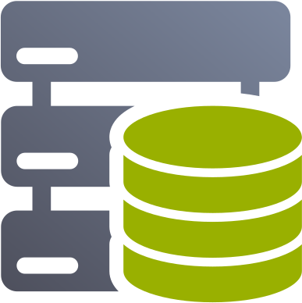
SDMX-RI: Diagram
Mapping Assistant
NSI Web Service
Web Client
Authentication Database
Mapping Store
Database
Dissemination
Databases

Slide 8
THANK YOU!

