Slide 1
UN Department of Economic and Social Affairs (UN DESA), Veronique Verbruggen
Policy and institutional
coherence and changing mindsets to increase the public administration’s effectiveness
Notes:
Dear participants, I am a Sr Interregional Advisor on Governance and Public Institutions at the United Nations Department for Economic and Social Affairs, based in New York Headquarters. The emphasis of the work of my division on Public Institutions and Digital Government is on building capacities and doing research in the area of SDG 16 and more in particular in supporting governments towards more effective, accountable, transparent and inclusive public institutions for the implementation of the SDGs. Taking sustainable development from theory into practice forces countries to rethink their governance.
I am grateful to be invited to this webinar on Institutional performance measurement and management, organized by UN ESCWA whom we have been working with for many years.
In line with one of the survey’s outcome that was distributed to 21 states in the region in November 2022, it appears that government effectiveness is still considered an area of challenge.
In my presentation, I would like to touch upon one of the aspect of how to increase the effectiveness of the public institutions which also has an impact on the legitimacy of the public institutions vis-à-vis the citizens.
With the increasing complexity of issues that governments are confronted with – to take only the COVID pandemic as an example, we have to ask ourselves as international and national public servants how effectiveness can be increased and whether our organizations are still set up for the challenges we are facing.

Slide 2


SDGs and policy coherence
Goal 17
Strengthen the means of implementation and revitalize the global partnership for sustainable development
Target 17.14 Enhance policy coherence for sustainable development
Notes:
The concept of sustainability is – as you all know - based on three core sustainability principles that include an environmental, social, and economic aspect, each focusing on the policies’ impact on those three aspects. This means that individual ministries do not have the sole control over their success, governments do not have the sole control over the success or failure of policies, or how citizens perceive their actions. This also means that ‘how’ the public sector works becomes increasingly more important than ‘what’ it specifically does. This has also an impact on how performance of policies should be assessed and that it is important to also assess performance on the cross-organization outcome level.
Which brings us to a key principle of the SDGs which is the interconnectedness of the SDGs or shortly referred to as policy coherence. Policy coherence for sustainable development is addressed in goal 17 and the target 17.14 is about applying approaches and policy tools to systematically integrate the social, economic and environmental dimensions of sustainable development at all stages of policy making.

Slide 3
Key concepts: Policy coherence for sustainable development
“systematically reduces conflicts and promotes synergies between and within different policy areas to achieve the outcomes associated with jointly agreed policy objectives” (Nilsson et al., 2012, p. 396)
  To identify trade-offs between policies. A trade-off is when an action enhances one system while negatively impacting another one.
  To foster synergies between policies & develop policies that simultaneously reinforce each other
Notes:
Trade-offs between policies - or reducing the number of actions that negatively impact another one - will always exist and are inevitable, but the issue is foster policies that mutually reinforce each other. Potential synergies offer benefits across multiple dimensions of sustainable development and for many groups.

Slide 4
Water-land interactions in the hydrological cycle
Water needs for food, feed, fuel and fibre crops (rain-fed and irrigated)
Biomass for biofuel production and other energy uses
Energy required for field preparation and harvest
Energy for production of fertilizer, pesticides and other agricultural inputs
Land and agriculture system
Climate
Energy system
GHG emissions
Water system
.
Precipitation, temperature
Energy for: water processing and treatment, water pumping, and desalination
Water for: hydropower, power plant cooling, and (bio-) fuel processing
Notes:
UN DESA supports countries in strengthening policy coherence and assess the synergies and trade-offs in the case of simultaneous implementation of highly interconnected systems like water, energy and land use that are impacted by or impact climate change. This can increase the impact and effectiveness of the policies. Also, the COVID pandemic has proven that a coherent approach between different policy fields is required to mitigate adverse impact as it touched upon individual rights issues, health policies, education policies.

Slide 5
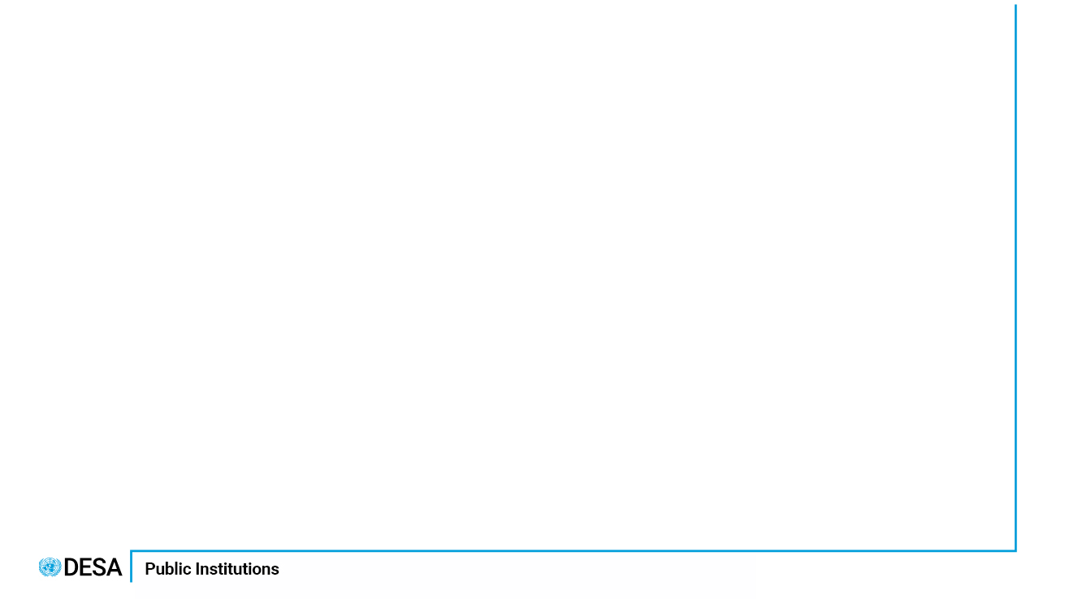
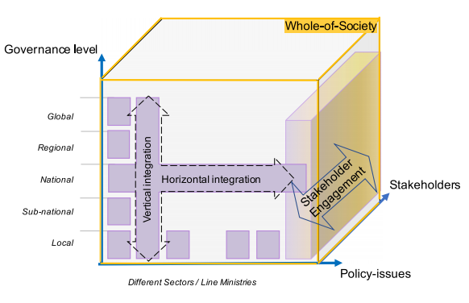
Institutional coherence as a precondition for policy coherence
Systematically identify relevant linkages across the sectors and domains and consider those linkages in design of policies;
Policies need to be consistent across sectors and scales (from local to global);
Engagement of relevant stakeholders in design, implementation, monitoring and evaluation;
Adequate resources are provided for implementation at all levels and at all scales
Notes:
Even if the interconnection between policies at a technical level is understood - what is important is that there is a need to collaborate with each other, with local government and with the private sector, the civil society organizations and the academic world. Civil society organizations for example can have insight and provide data and evidence about how to mitigate disaster risks. The private sector would need to be aware and involved in policy making if they are asked to contribute to financing certain programmes or policies. The academic world can strengthen the evidence-base of government policies.
Improving Coherence requires institutionanal collaboration across different dimensions:
Horizontally - between different policy areas / economic, social, governance and environmental aspects of policies and between different ministries
Vertically –between national and local and national and International level and ensure transboundary considerations
Yet, merely admitting that all SDGs are connected to each other is not a useful policy message. Addressing the social, economic, and ecological dimensions of sustainability already faces resistance and antagonism among actors, each having conflicting interests, power relations and budgets.

Slide 6
collaborations across Government
Example of Youth in NEET as outcome indicator and its causes of outcomes and consequences of outcomes
Example from Seychelles
Mismatch in skills & market needs
Youth NEET
Harmful use of alcohol
Mortality rate due to NCDs, road accidents
Ministry of Education
Ministry of Economy
Ministry of Health
Ministry of Health
Ministries of Justice, Transport

Slide 7
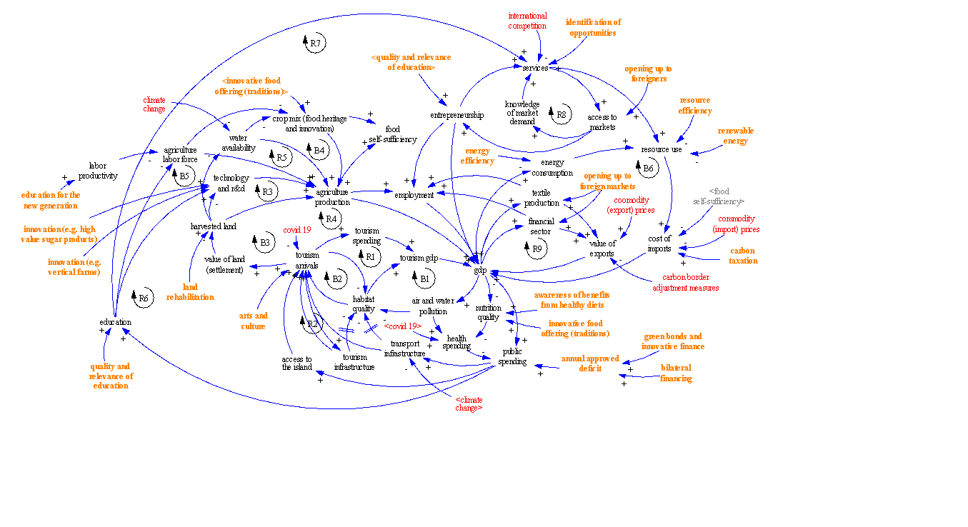
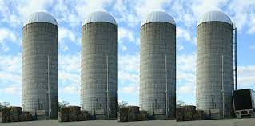
Incongruence btw organizational structure vs. interdependance of policy problems
Interconnections btw policies
Policy formulation, planning & implementation in bureaucracies
Notes:
There is currently still in many organizations a discrepancy between the interconnectedness that is characteristic for the SDGs/ policies despite the fact that we have some good practices and the silo character of ministries. Because Linear and siloed thinking is not sufficient to tackle complex problems, systems thinking-based approaches like the system maps as designed in the left part of the slide can help identify and visualize the interaction with different actions and its type of connection (positive or negative) can be developed. What is key however is that these collaboration mechanisms are functional and not only procedural.

Slide 8
Building blocks for policy coherence
Notes:
UNEP is the custodian for policy coherence indicators which have been developed for different Building Blocks which include indicators relating to the extent to which a political commitment for policy coherence has been institutionalized through legal and normative frameworks in support of the implementation of the national development agenda. Other building blocks include criteria that assesses the policy linkages and the assessment of policy effects; the existence of inter-ministerial collaboration mechanisms and financing policy coherence or the use of digital technology and data for policy coherence or the level of coherence between national and local/regional level or whether there are functional mechanisms established for engaging stakeholders in strengthening policy coherence.

Slide 9
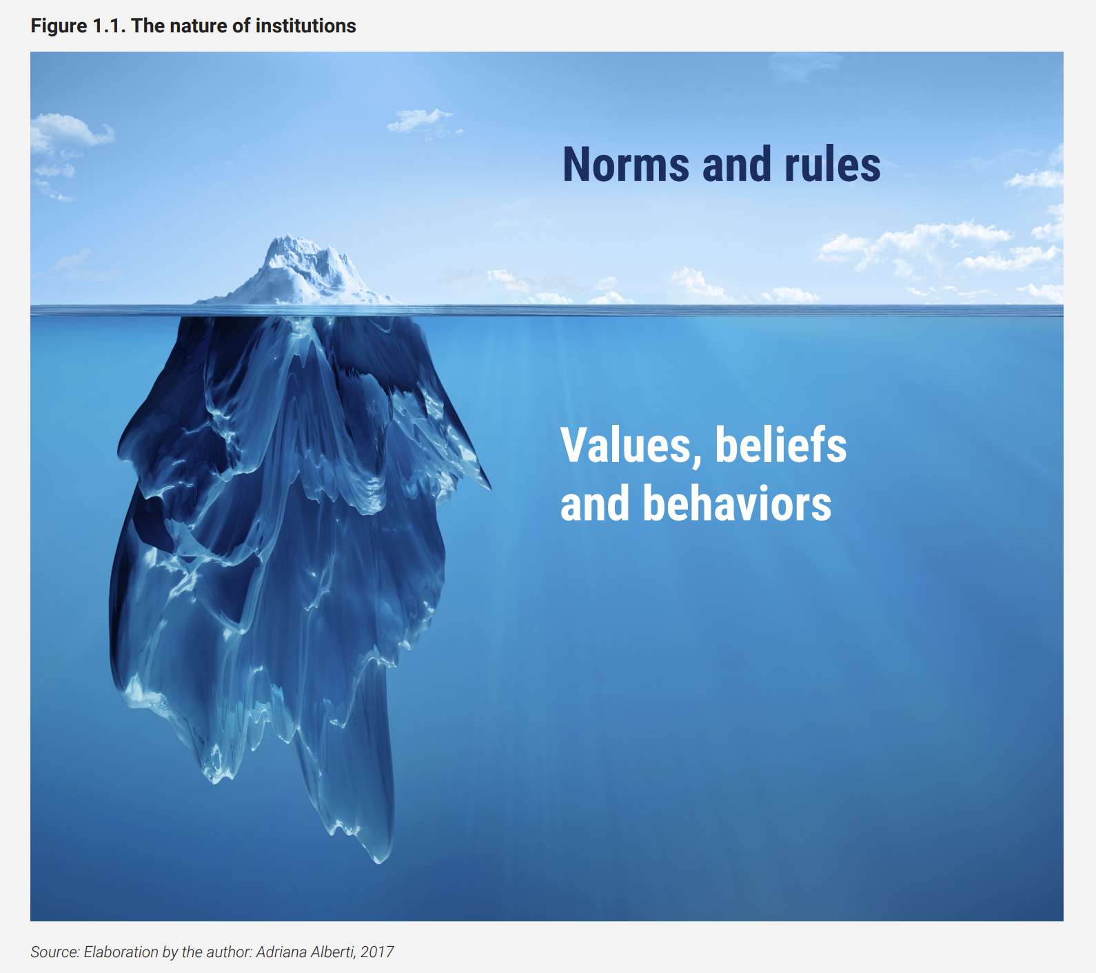
Why is it important to change mindsets to promote effective institutions for sustainable development?
Understanding the nature of institutions and institutional change
Institutional change does not mean a change of rules and goals per se. It also implies changing the beliefs and attitudes (mindsets), and values of public servants to reorient behavior to attain those goals. Above all, it means behavioral changes that enact the new prescriptions for action which are implied by the new rules.
Visible part
Dual nature
Hidden part
Notes:
It is clear that institutional changes are required to improve policy coherence for a more effective government. It is therefore essential to considering why changing mindsets is critical for institutional effectiveness.
Institutions are composed of a visible part constituted by its formal rules and structures and a hidden part that is constituted by the underlying value-system that informs behaviors and is consolidated through time. Public servants are the key drivers of change in public sector organizations. Only when public servants are able to translate formal prescriptions into actual behavior can an institution be able to achieve its results. Thus, institutional change does not mean a change of rules and goals per se. It also implies changing the beliefs and attitudes (mindsets), and values of public servants to reorient behavior to attain those goals. Above all, it means behavioral changes that enact the new prescriptions for action which are implied by the new rules.

Slide 10



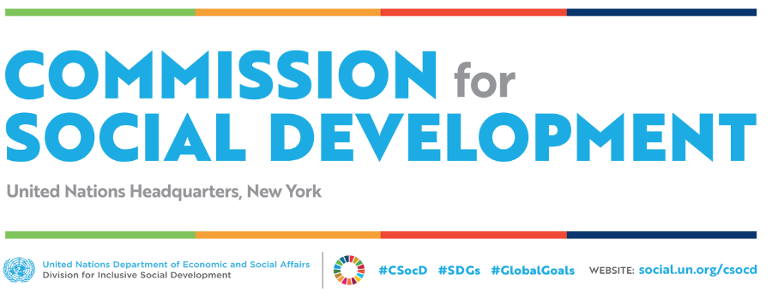
Effective Governance for the Sustainable Development Goals
Capacity Development Curriculum
Available at UN Public Administration Network (UNPAN) Website
unpan.un.org
Division for Public Institutions and Digital Government
publicadministration.un.org
unpan.un.org
Notes:
As the survey has shown that public sector reform for the implementation of the SDGs continues to be a major challenge in many countries.
UN DESA has developed a Curriculum to support member states with enhancing effective governance for the SDGs. We developed 10 toolkits for Training trainers, in particular for schools of public administration, but it could also be offered to governments directly that aim to provide a holistic and integrated framework for capacity development in the area of governance and public institutions.
We worked with experts from different countries, different UN departments (like UNEP, UN DRR, UNPOG) and UN DESA divisions contributed, UNPAN members were asked to provide comments.
All toolkits comprise of a number of modules, each of them containing a facilitator guidance, reading material, theoretical background, tools and approaches, activities and discussions and exercises + good practice cases.

Slide 11





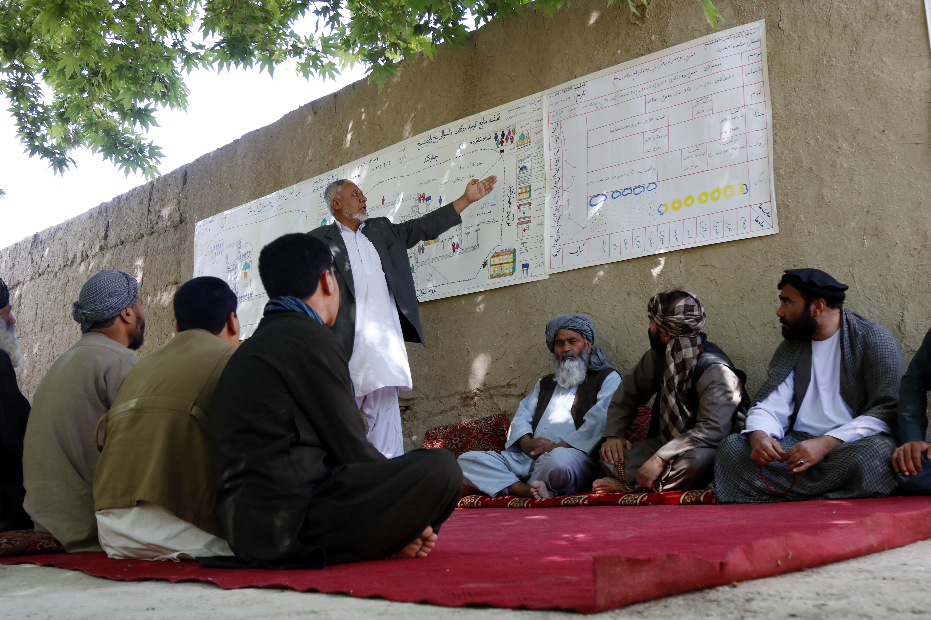
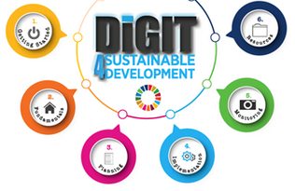
What are the Topics of the Curriculum on Governance for the SDGs?
CHANGING MINDSETS IN PUBLIC INSTITUTIONS TO IMPLEMENT THE 2030 AGENDA FOR SUSTAINABLE DEVELOPMENT
GOVERNMENT INNOVATION FOR SOCIAL
INCLUSION OF VULNERABLE GROUPS
UN DESA | DPIDG
Training of Trainers I English
UN DESA | DPIDG | UNPOG
Training of Trainers I English
UN Photo/Rick Bajornas
UN Photo/Rick Bajornas
TRANSPARENCY, ACCOUNTABILITY AND ETHICS IN PUBLIC INSTITUTIONS
RISK-INFORMED GOVERNANCE AND INNOVATIVE TECHNOLOGY FOR DISASTER RISK REDUCTION AND RESILIENCE
UN DESA | DPIDG | UNPOG
Training of Trainers I English
UN DESA | DPIDG
Training of Trainers I English
UN Photo/Yutaka Nagata
UN DRR Photo
INSTITUTIONAL ARRANGEMENTS AND GOVERNANCE CAPACITIES FOR POLICY COHERENCE
INNOVATION AND DIGITAL GOVERNMENT FOR PUBLIC SERVICE DELIVERY
UN DESA | DPIDG
Training of Trainers I English
UN DESA | DPIDG
Training of Trainers I English
UN Photo/Eskinder Debebe
UN photo
EFFECTIVE NATIONAL TO LOCAL PUBLIC GOVERNANCE FOR SDG IMPLEMENTATION
DIGIT4SD: DIGITAL GOVERNMENT IMPLEMENTATION
UN DESA | DPIDG | UNPOG
Training of Trainers I English
UN DESA | DPIDG
Training of Trainers I English
Rumi Consultancy/World Bank
Notes:
The toolkit on institutional arrangements for policy coherence focuses on addressing the different building blocks that I just elaborated upon and builds capacities for improving inter-ministerial coordination and vertical coordination, including between national and local government and non government level.
​In line with this toolkit, we developed an e-earning tool in collaboration with UNITAR on integrated policies and policy making and this tool could help bridge the gap between short term recovery planning following the pandemic and long tern development planning, again by helping participants understand the interconnections between the SDGs and the need to consider the trade offs, synergies between the SDGs. We have used this already in Mauritius and Seychelles and some other countries
We also developed a toolkit on national to local public governance which focuses on the need to align national with local policies and also engage meaningfully with the private sector, the academics and civil society. The toolkit also deals with various innovative financing mechanisms to advance local SDG implementation.
The toolkit on risk-informed governance and innovative technology for disaster risk reduction and resilience aims at exploring the mechanisms for access, adoption, uptake, finance, and maintenance of emerging technology in practical formats that seek to advance public sector capacities for risk-informed policymaking and resilience.
The toolkit on transparency, accountability and ethics intends to promote public servants' ethical awareness and transform mindsets for ethical behavior and decision-making, enabling them to become change agents and lead on integrity transformations.
Upon completion of the course, learners will have: ​
Undertaken a values assessment vis-a-vis the SDGs and map capacity gaps and opportunities.
Raised awareness of concepts, and practical mechanisms for integrity and anti-corruption, focusing on international frameworks and standards, laws and institutions at the national level, organizational tools and processes, as well as behavioral insights to translate formal rules into desired behaviors.
Mapped and engaged with key stakeholders in defining an ethics and integrity strategy.
Developed a roadmap and an action plan to incorporate relevant knowledge into public servants' day-to-day work. ​
A toolkit on innovaton and digital government for public service delivery will also help and addresses challenges related to the responsiveness, quality, affordability, accessibility and people-orientation​ of their service delivery. It also uses system thinking and design thinking.
For more information I would advise you to go to the unpan website and download the toolkits that are free. In case you have questions, you can contact me.

Slide 12
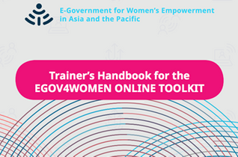


What are the Topics of the Curriculum on Governance for the SDGS?
E-GOVERNMENT FOR WOMEN'S EMPOWERMENT
UN ESCAP & UN DESA | DPIDG | UNPOG
Training of Trainers I English
INTEGRATED POLICIES AND POLICY COHERENCE FOR THE SDGs
UNITAR, ECLAC & UN DESA | DPIDG I DSDG
Training of Trainers I English

Slide 13
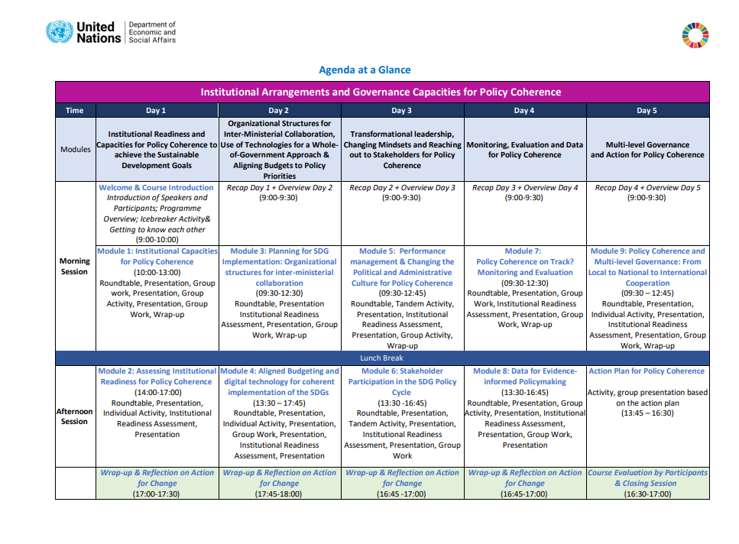

Slide 14
Thank you.
For more information: verbruggen2@un.org
Curriculum on governance for SDGs (un.org)

