Slide 1
A Multidimensional Poverty Index (MPI)
Christian Oldiges, PhD
Senior Economic Affairs Officer
christian.oldiges@un.org

Slide 2
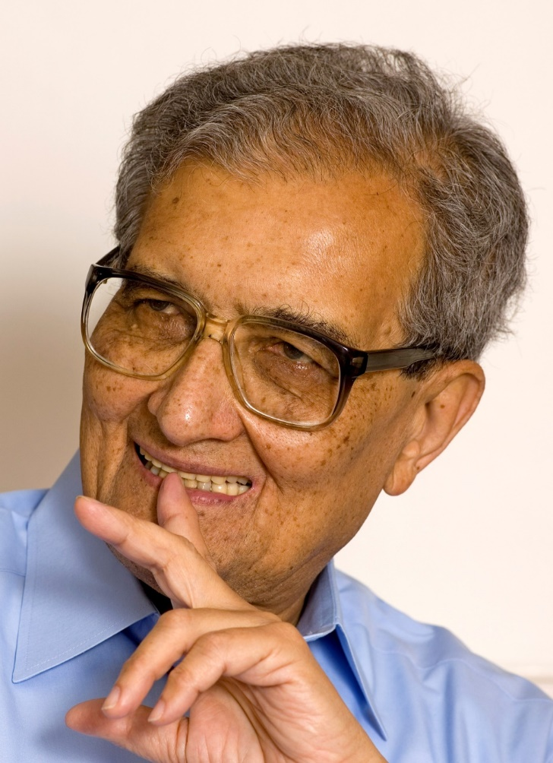
Human Development
Human lives are battered and diminished in all kinds of different ways, and the first task… is to acknowledge that deprivations of very different kinds have to be accommodated within a general overarching framework
Nobel Laureate Amartya Sen (2000)

Slide 3
Why measure? The link to policy
“Learning about the extent of poverty is important… but it is the link with action that marks out this issue from many other subjects of study in the social sciences. Poverty statistics matter because they motivate people to tackle a key challenge.” (2019, p. 1)
Behavior and measurement

Slide 4
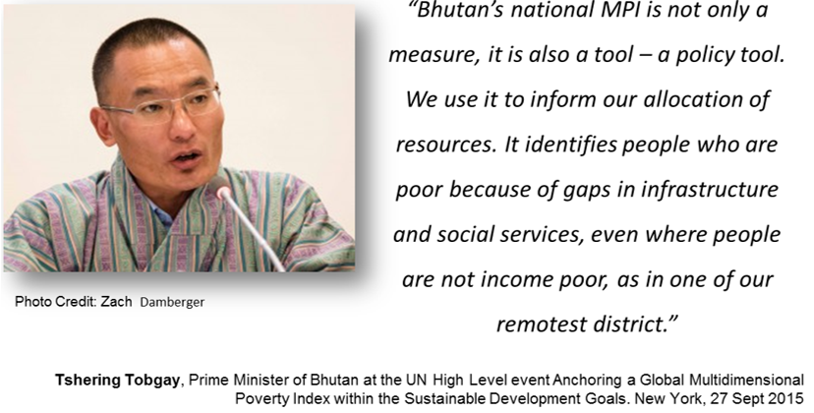
Why Measure?
“Measures are like eyes
They help us to see things
They bring matters into focus.”

Slide 5
SDG 1

Slide 6
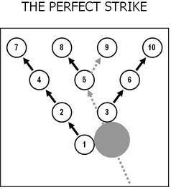
Development and National Planning as a bowling strategy: Priorities and interlinkages

Slide 7
A simple question …
A Dashboard: Across 101 countries and 5.2 billion people:
53% of the considered population lack clean cooking fuel
40.2% lack adequate sanitation by MDG definitions
26.5% live in houses where floors are dirt, sand, or natural
26.8% have someone in their household who is undernourished
21.8% lack electricity
16.9% of people live in houses where a child has died
25.1% lack safe water by MDG definitions
13.6% live in a household where a child is not attending school up to class 8.
13.6% live in a household in which no member has completed five years of schooling.

Slide 8
A simple question …
A Dashboard: Across 101 countries and 5.2 billion people:
53% of the considered population lack clean cooking fuel
40.2% lack adequate sanitation by MDG definitions
26.5% live in houses where floors are dirt, sand, or natural
26.8% have someone in their household who is undernourished
21.8% lack electricity
16.9% of people live in houses where a child has died
25.1% lack safe water by MDG definitions
13.6% live in a household where a child is not attending school up to class 8.
13.6% live in a household in which no member has completed five years of schooling.
How many people have more than 1 deprivation?

Slide 9
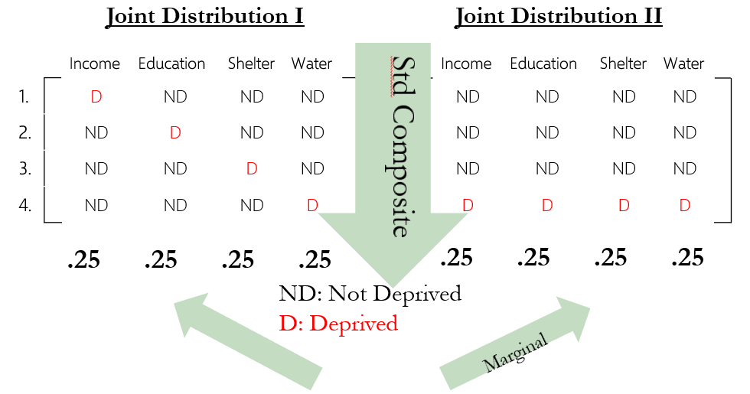
Measurement using a dashboard

Slide 10
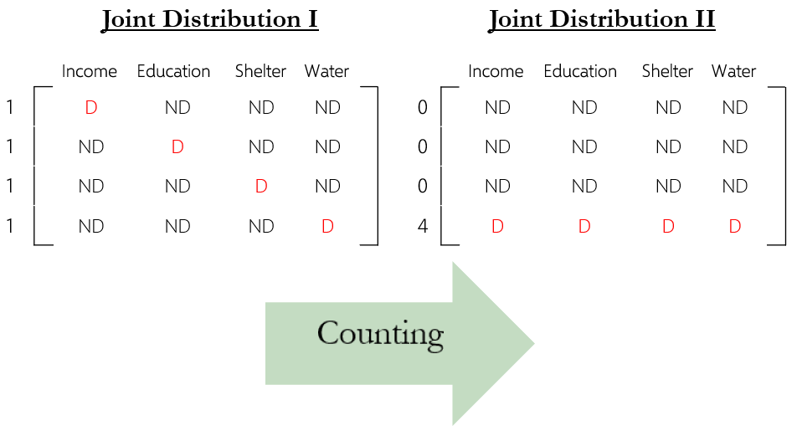
Aggregate horizontolly

Slide 11
Simple Counting Method: Alkire Foster Methodology
Applied for:
Global MPI (UNDP & OPHI)
Arab MPI (UN ESCWA)
National MPIs in 50+ countries & several Arab Member States (Palestine, Iraq, Egypt, …)
to inform policy!
Bhutan Gross National Happiness Index
Women Empowerment in Agriculture Index
Business MPI

Slide 12
A F: Intuitive explanation! (to simplify we assume equal weights in this example)
Matrix of deprivation scores for 4 persons in 4 dimensions
Who is deprived in what?
 | Schooling | Food | Water | Housing
y = | ND | ND | ND | ND | Nadif
 | D | ND | ND | D | Alaa
 | D | D | D | D | Chris
 | ND | D | ND | ND | Said

Slide 13
How poor? How many deprivations?
 | Schooling | Food | Water | Housing
y = | ND | ND | ND | ND
 | D | ND | ND | D
 | D | D | D | D
 | ND | D | ND | ND
0
2
4
1

Slide 14
Who is Poor?
Fix poverty cut-off k, identify as poor if ci >= 2
 | Schooling | Food | Water | Housing
y = | ND | ND | ND | ND
 | D | ND | ND | D
 | D | D | D | D
 | ND | D | ND | ND
0
2
4
1
Multidimensional Poverty Headcount (H)= 2/4 = ½ = 50%
[50% of the population are poor]

Slide 15
How poor are the poor?
Fix poverty cut-off k, identify as poor if ci >= 2
 | Schooling | Food | Water | Housing
y = | ND | ND | ND | ND | 0
 | D | ND | ND | D | 2
 | D | D | D | D | 4
 | ND | D | ND | ND | 1
.
2/4
4/4
.
Intensity of deprivation among the poor A=(2/4+4/4)/2= 6/8=¾ = 75%
[on average the poor are deprived in 75% of the dimensions]

Slide 16
The Multidimensional Poverty Index
 | Schooling | Food | Water | Housing
y = | ND | ND | ND | ND | 0
 | D | ND | ND | D | 2
 | D | D | D | D | 4
 | ND | D | ND | ND | 1
.
2/4
4/4
.
Headcount Ratio (H) = 2/4
Average Intensity of Poverty (A)= 6/8 = 3 / 4
MPI = H x A
= (2/4)x(3/4) = 6/16

Slide 17
Public Policy Intervention
INTERVENTION
 | Schooling | Food | Water | Housing
y = | ND | ND | ND | ND | 0
 | D | ND | ND | D | 2
 | D | D | D | D | 4
 | ND | D | ND | ND | 1
.
2/4
4/4
.
Headcount Ratio (H) = 2/4
Average Intensity of Poverty (A)= 6 / 8 = 3/4
MPI = H x A
= (2/4)x(3/4) = 6/16

Slide 18
Public Policy Intervention
 | Schooling | Food | Water | Housing
y = | ND | ND | ND | ND
 | D | ND | ND | D
 | ND | D | D | D
 | ND | D | ND | ND
0
2
3
1
INTERVENTION
.
2/4
3/4
.
Headcount Ratio (H) = 2/4
Average Intensity of Poverty (A)= 5 / 8
MPI = H x A
= (2/4)x(5/8) = 5/16

Slide 19
Individual deprivation profiles

Slide 20
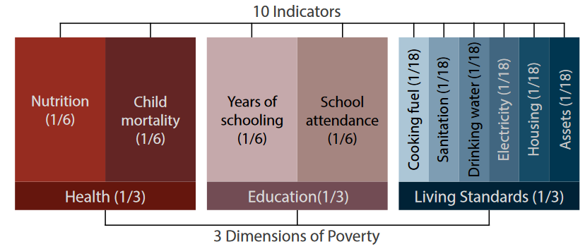
Source of graphics: OPHI
Key steps
Design an index with dimensions and indicators. Indicators include cut

Slide 21
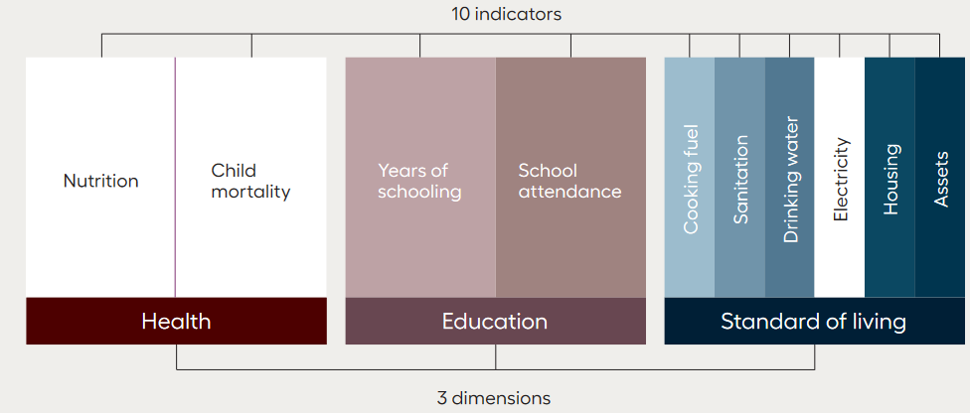
Key steps
Create individual deprivation profiles
Source of graphics: OPHI

Slide 22
Key steps II
Set poverty cut-off
Example: 1/3 or 33.33%
Determine who is poor
1/6+1/6 +5*(1/18) = 0.61 = 61%
Source of graphics: OPHI

Slide 23
Aggregation
Do so for all population
Calculate H: headcount ratio or incidence of poverty. Percentage of people who are multidimensional poor. (How many poor?)
Calculate A: intensity of poverty. Average number of deprivations among the poor. (How poor are the poor?)
Calculate MPI:
H * A = MPI
Calculate headcount ratios for each indicator
Calculate contributions to MPI for each indicator
Calculate H, A, MPI for all regions

Slide 24
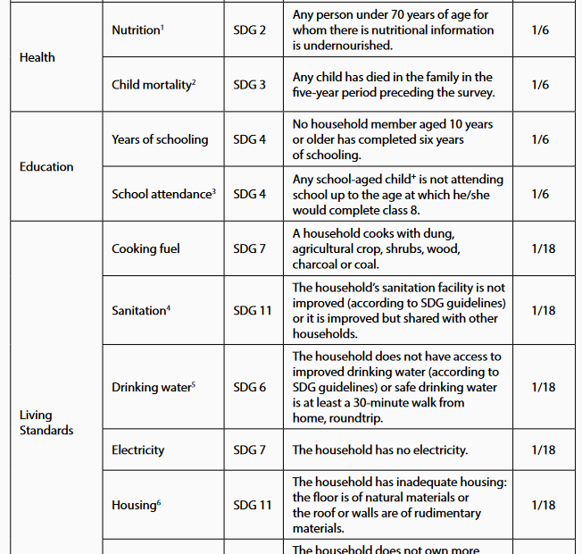

Slide 25
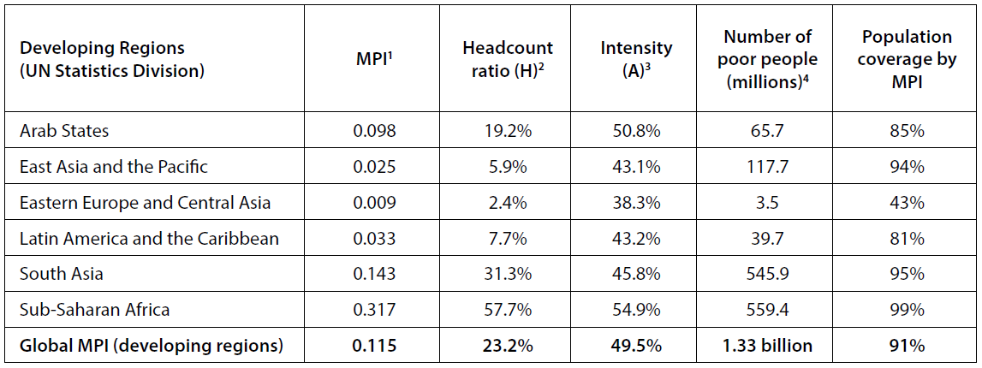
Global MPI 2018: 1.3 billion people MPI poor
Source of graphics: OPHI 2018

Slide 26
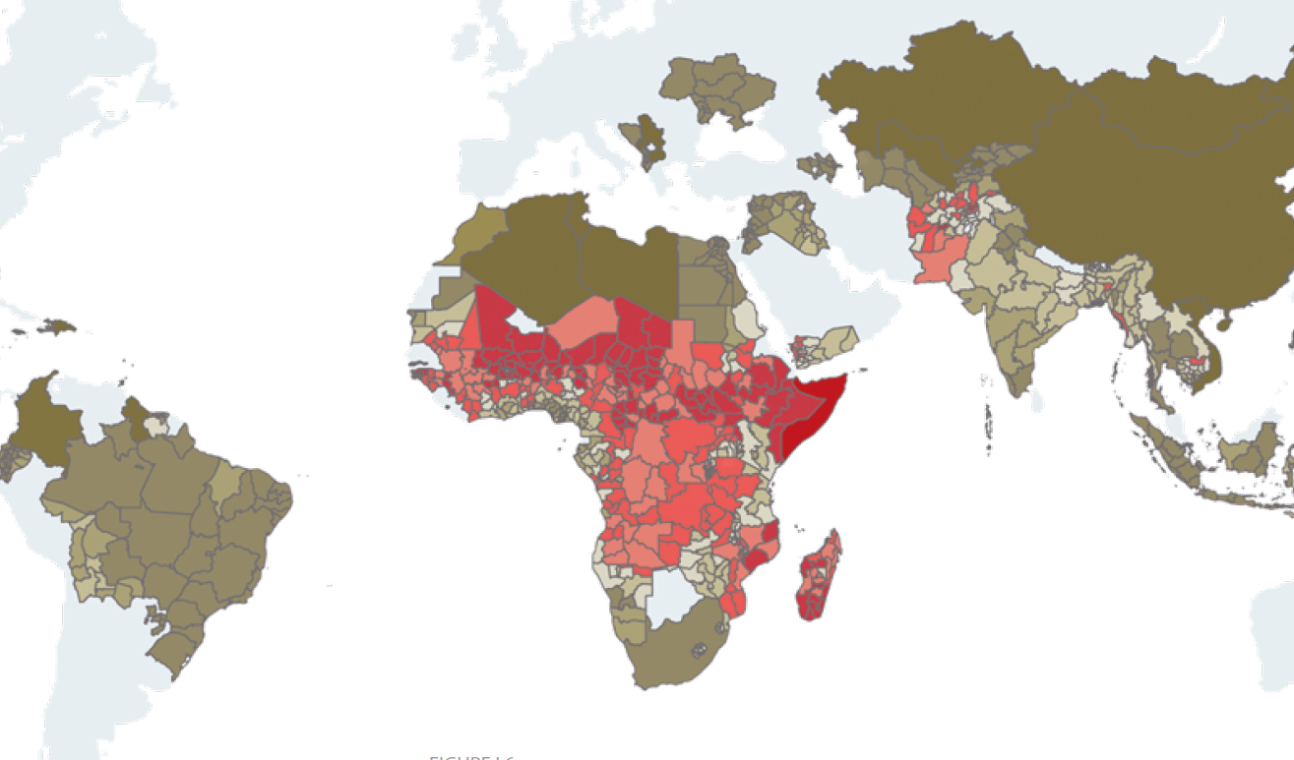
Global MPI 2018: Somalia in comparison
Source of graphics: OPHI 2018

Slide 28
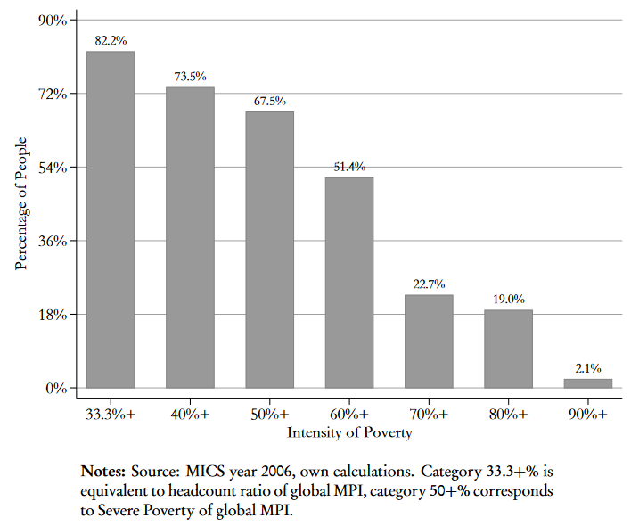
Global MPI 2018: Somalia profile
Source of graphics: OPHI 2018

Slide 29
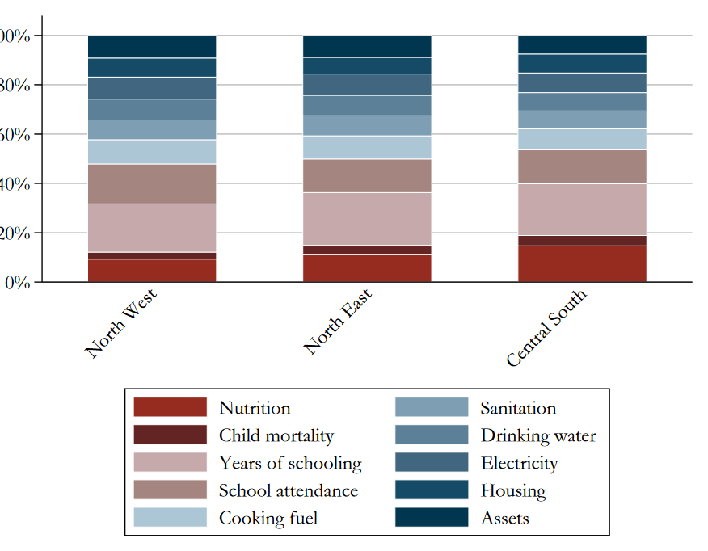
Global MPI 2018: Somalia profile
Source of graphics: OPHI 2018

Slide 30
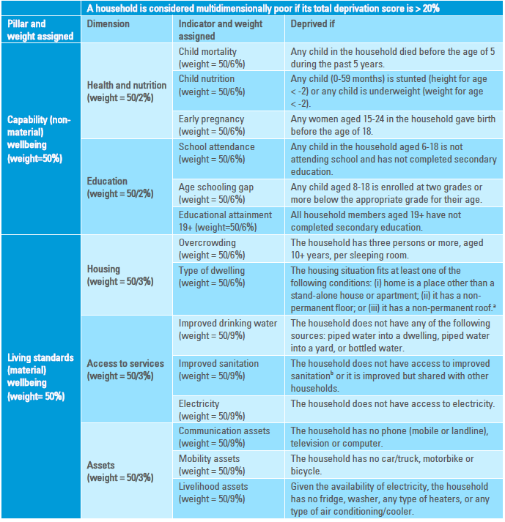
Example: Revised Arab MPI 2020
Source of graphics:
UN ESCWA 2020

Slide 31
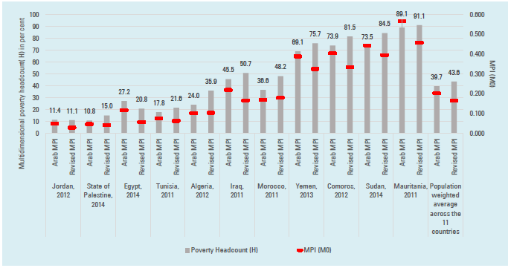

Slide 32
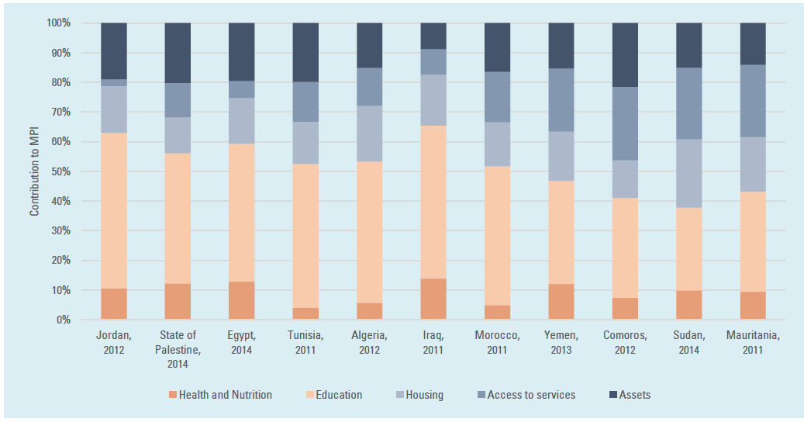
Example: Revised Arab MPI 2020
Source of graphics:
UN ESCWA 2017

Slide 33
Who is Using MPIs and the Counting Approach?
Governments
Many national measures; MPPN 60 countries
United Nations
2010 Global MPI (2016 Arab MPI by UN ESCWA & Revised Arab MPI 2022)
2015 Sustainable Development Goals (SDGs)
Target 1.2: by 2030, reduce at least by half the proportion of men, women and children of all ages living in poverty in all its dimensions according to national definitions
Indicator 1.2.2: Global MPI and national MPI’s are reported in Voluntary National Reviews by governments.
World Bank
2016 Poverty Commission (Atkinson Report)
Recommendation 19: The Complementary Indicators should include a multidimensional poverty indicator based on the counting approach.

Slide 34
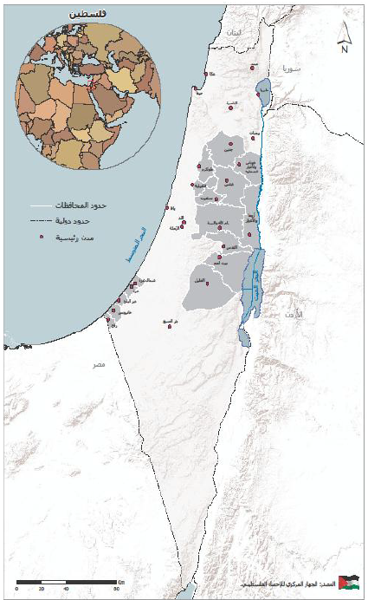
National MPI:
Example Palestine
Launched in 2020
Data from 2017

Slide 35
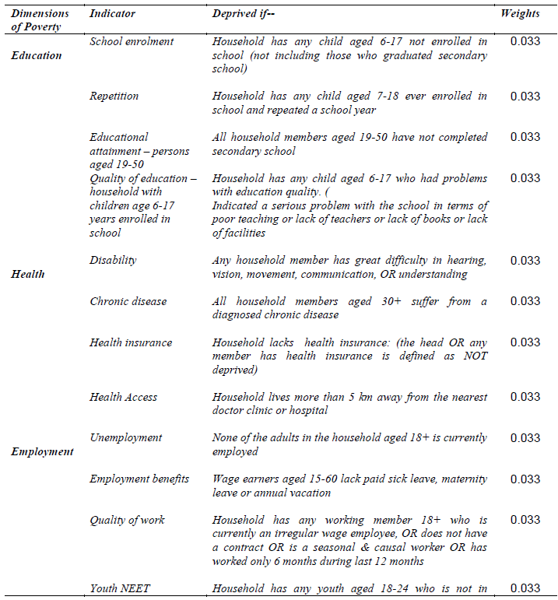
The Palestine MPI

Slide 36
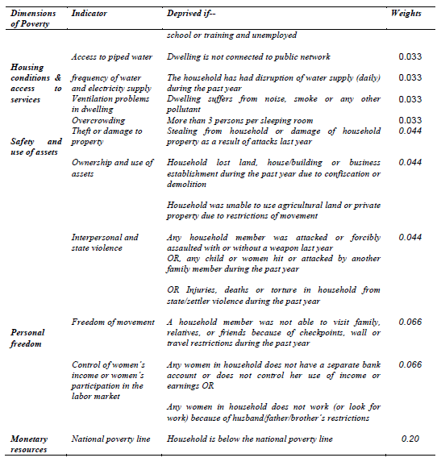

Slide 37
Palestine MPI: Disaggregations by regions / subgroup
The Palestine MPI

Slide 38
Palestine MPI: Contributions

Slide 39
Going forward
Think of ideal indicators for Somalia …

