Slide 1
MPI as a Governance Tool
Mónica Pinilla-Roncancio

Slide 2
“A number can awaken consciences; it can mobilize the reluctant, it can ignite action, it can generate debate; it can even, in the best of circumstances, end a pressing problem”
Numbers that Move the World
by Miguel Szekely (2005, 13).
Notes:
Many countries in the world and in the region have had poverty measures that are periodically updated for a long time.
SDG 1 is now requiring countries to complement monetary measures of poverty with a multidimensional one, building into the notion of leaving no one behind.
As you all know, the adoption of MD poverty within the SDGs came after serious deliberation and debates about what it means to live in poverty. Member countries agreed, as has the academia and international agencies, that poverty is a multidimensional phenomenon and that lives of the poor are affected in many ways and by many hardships.
Taking poverty to a MD space comes with the task of first developing a MD approach to measure poverty – ultimately, to computing a MPI, like some countries in the region have already done.
We have discussed in previous meetings the Alkire-Foster method, which is the methodology behind the MPI, so I’m not going to get into this with too much detail, just a brief review. The presentation will be mostly focus on who to engage policymakers in the development of a MPI.

Slide 3

How do these connect?
- SDG Indicators covering multiple dimensions of poverty
Integrated, Multisectoral Policies
(break Silos & coordinate)
Leaving No One Behind (Disaggregated Data)
Governance
(but it’s a handful!)

Slide 4
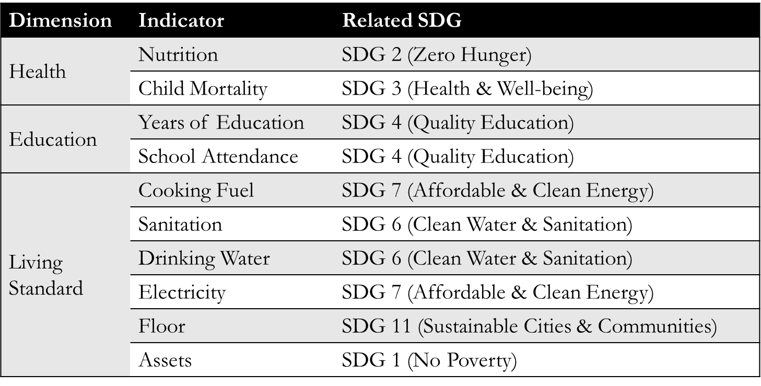
MPIs jointly analyse multiple SDGs
Example: Global MPI

Slide 5

How do these connect?
- SDG Indicators covering multiple dimensions of poverty
MPIs: a headline and the
indicator level detail
on interlinkages
Integrated, Multisectoral Policies
(break Silos & coordinate)
Leaving No One Behind (Disaggregated Data)
MPI
Governance
MPI makes it
manageable

Slide 6
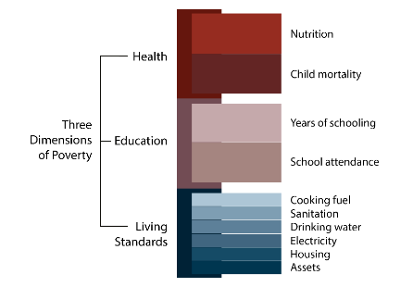
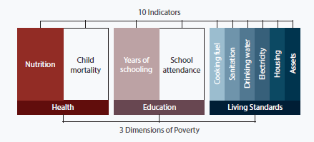
Computing any MPI
1. Consider the indicators
2. Build a Deprivation Profile for each person
This deprivation score is 1/6 + 1/6 + 6(1/18) = 2/3
3. Identify Who is Poor Using Poverty Cutoff (1/3):
If deprivation score > poverty cutoff, person is poor. Here, 2/3 > 1/3, so the person is identified as poor.
4. Compute MPI
MPI = H x A
H “Incidence”= Headcount ratio of those identified as poor
A “Intensity”= Average deprivation score of all poor people
Notes:
New labels for Living Standard variables, old picture is behind

Slide 7
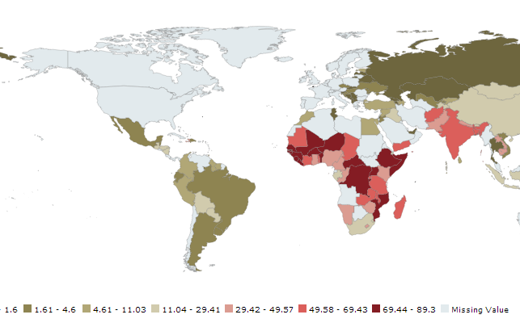
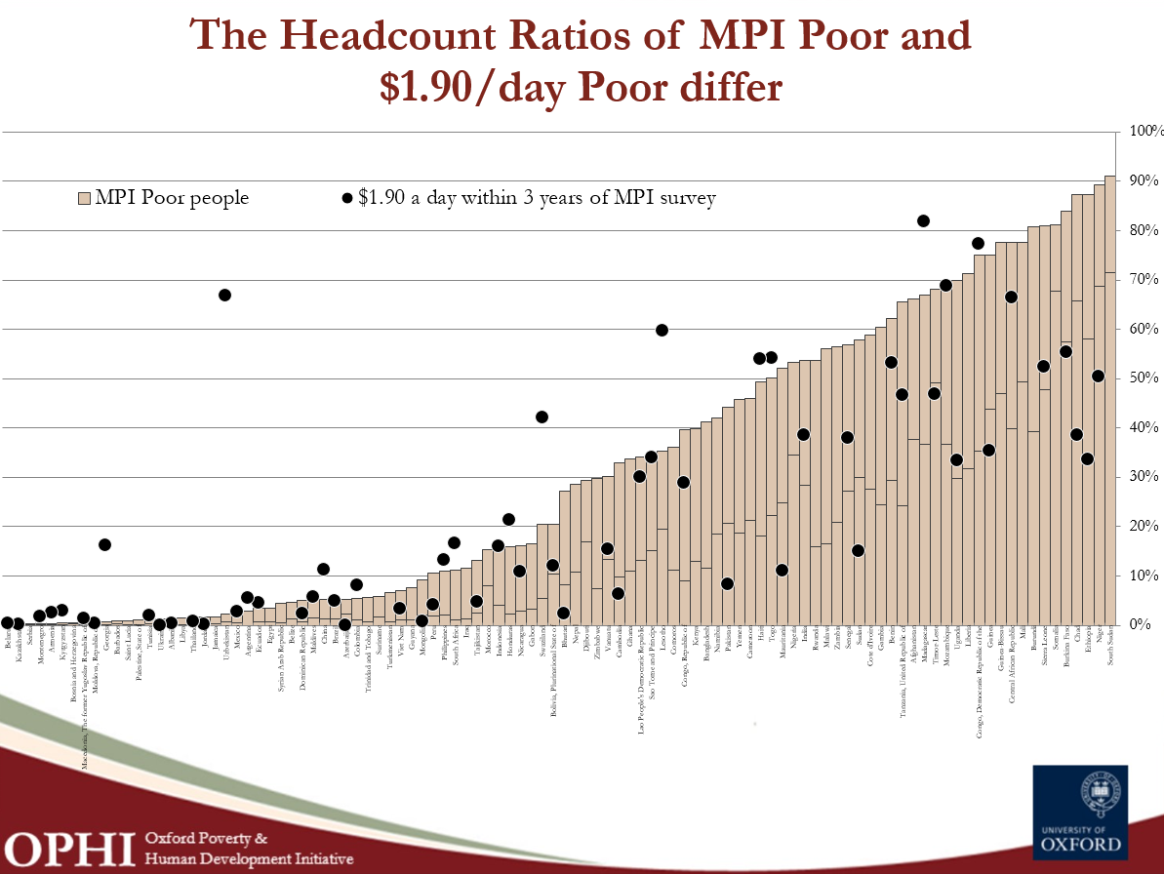
Comparable MPI (Global MPI, ECLAC MPI. Arab MPI)
- Like $1.90/day and $3.10/day poverty measures
- Can also compare countries (& subnational groups, over time)
- Could track SDG-1: halve poverty in its many dimensions
- Could measure both acute and moderate poverty
- Not as useful for national policy
Notes:
We have discussed in previous meetings the Global MPI, which is a specific adaptation of the AF method to build an internationally comparable measure of acute MD poverty. The Global MPI was launched in 2010 by OPHI and UNDP, and has been updated periodically since. It’s alike the USD 1.90/day measure in that it allows for comparisons across countries and over time, and could be used to track progress globally on SDG 1.2.
However, the Global MPI is not necessarily useful for some countries to guide national poverty reduction policies. We have seen, for instance, in previous meetings that the Global MPI figures for this region are very low, not accurately representing what poverty is in these countries. So, some regions of the world have developed regional MPIs that still allow relevant comparisons across neighboring countries, but with dimensions/indicators/cutoffs that are tailored to the regional context. The LAC region was the first one to experiment with this, and just last week the League of Arab States launched the regional Arab MPI during UNGA. The Arab MPI has levels of deprivations that better describe poverty in middle-income countries, and includes relevant regional indicators such as FGM.

Slide 8
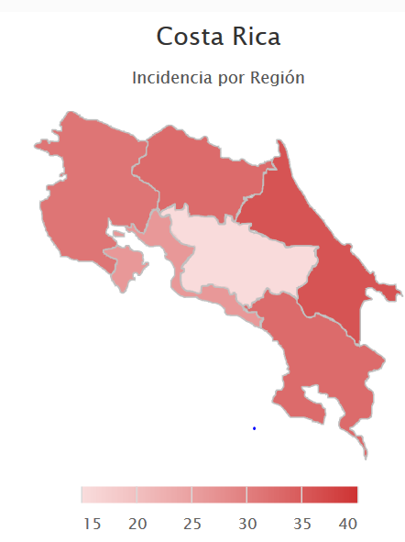
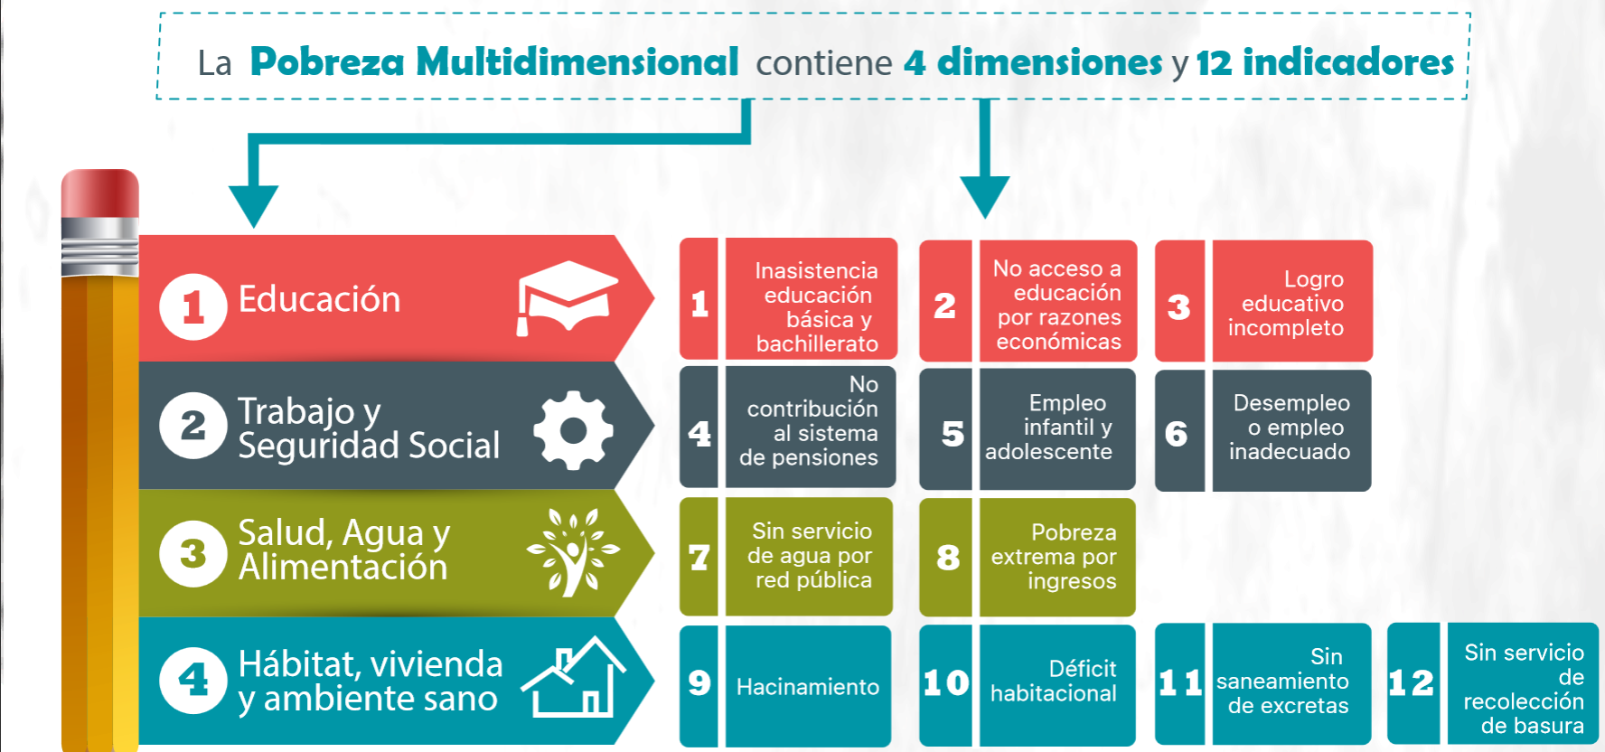
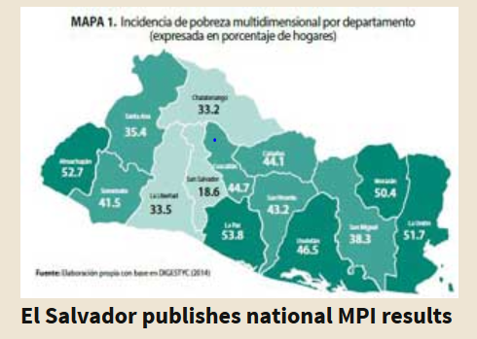
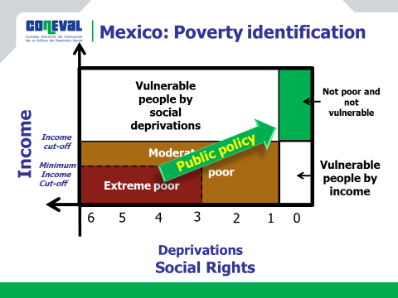
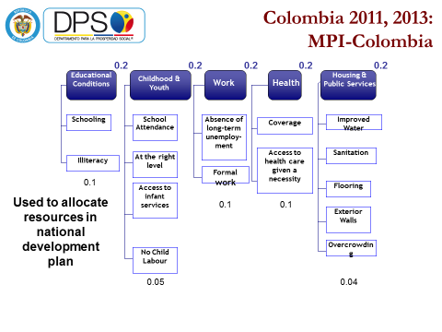
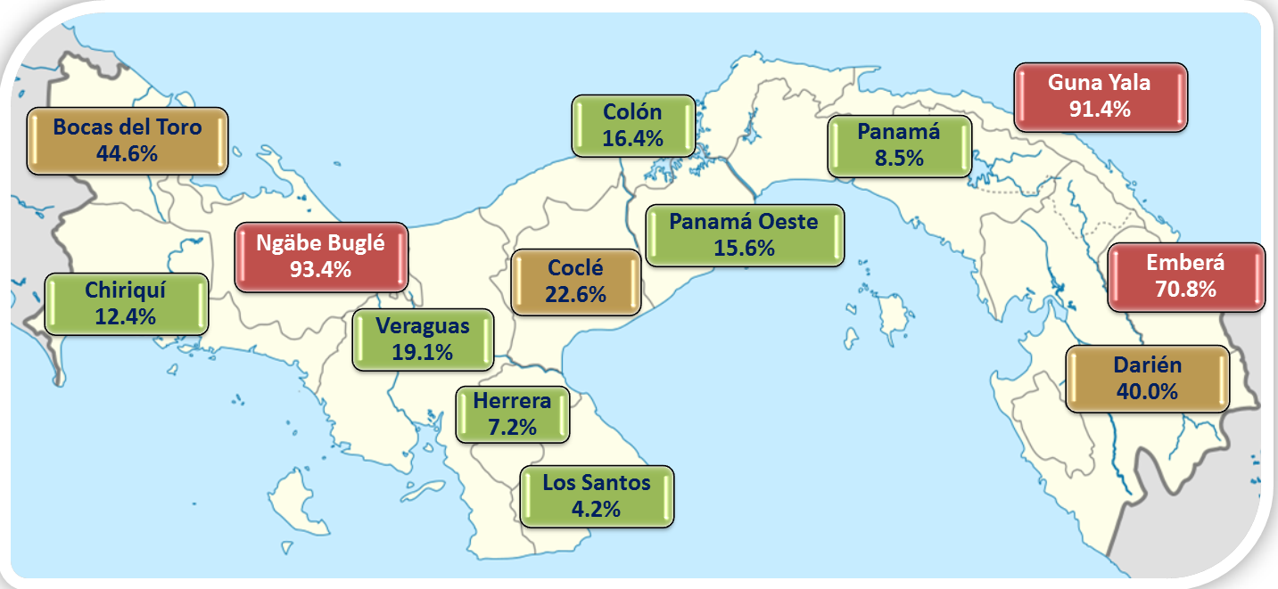
National MPIs: Tailor made for policy
- Reflects the national context and priorities
- Guides national policies – focalization, monitoring, coordination
- Useful for policy interventions but not internationally comparable
Notes:
In addition to the regional measures, as you know, many countries have opted to create their own national measures to tailored them even more to the national context and priorities. We even have some examples here in the region. The way in which the process of developing national (or regional) MPIs took place was of course different in every country. However, the countries who have been the most successful in actively using the MPI for policy guidance and monitoring have all shown a high level of involvement of policymakers – in particular, of very high rank.

Slide 9
1. Panoramic view – It can be disaggregated (‘leave no one behind’): a. by region, ethnic group, rural/urban, gender, disability, age group, etc. b. by indicator, to see composition c. by ‘intensity’ to see inequality among the poor
2. Value added – focus in overlapping deprivations (joint distribution)
3. Incentives to reach the poorest of the poor
4. Flexible to select dimensions/indicators/cutoffs/etc.
5. Robust to range of weights and cutoffs
6. Shows progress immediately
What’s new?
Notes:
Now, the first thing that’s needed to engage policymakers into the process is to explain what’s the value added of having an additional measure of poverty.
There are several ways to compute MD poverty, but the MPI in particular has received a lot of attention in the last few years because of a serious of advantages of the methodology.

Slide 10
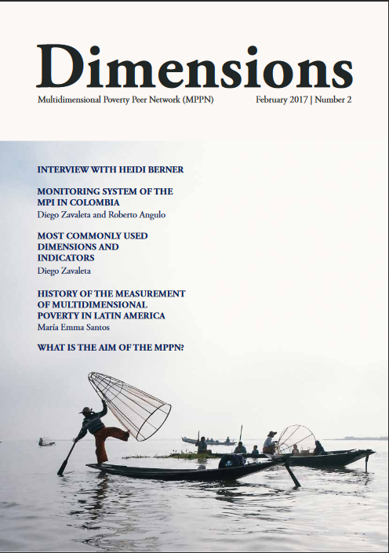
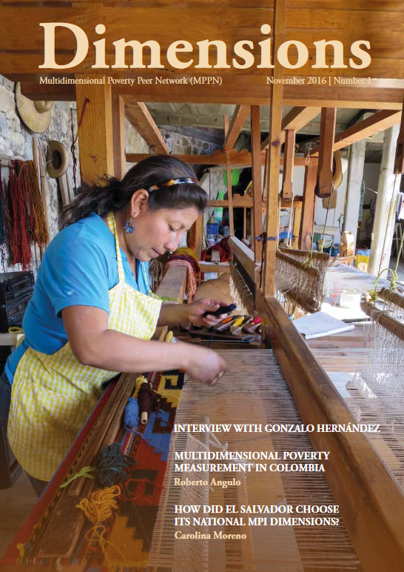
Policy makers are using their national MPIs to:
Complement monetary poverty statistics
Track poverty over time (official statistics)
Allocate resources by sector and by region
Target marginalized regions, groups, or households
Coordinate policy across sectors and subnational levels
Adjust policies by what works (measure to manage)
Leave No One Behind see the poorest & track trends
Be Transparent so all stakeholders engage – NGOs,
    Private Sector etc, all parts of government.
Notes:
New labels for Living Standard variables, old picture is behind

Slide 11
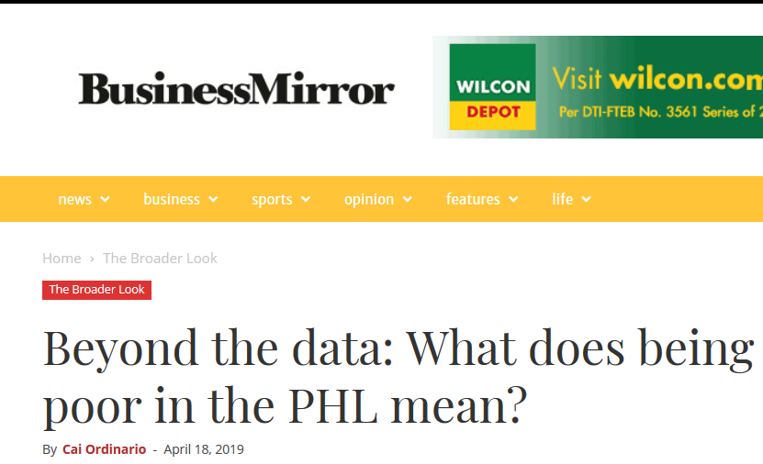
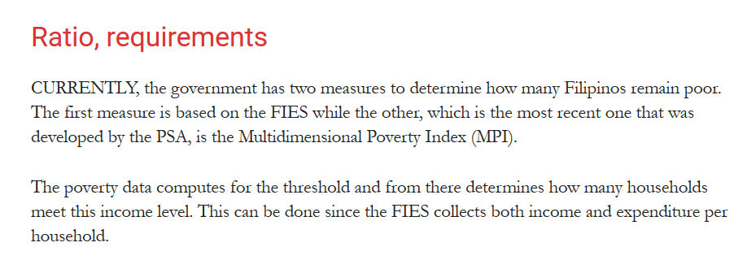

Slide 12
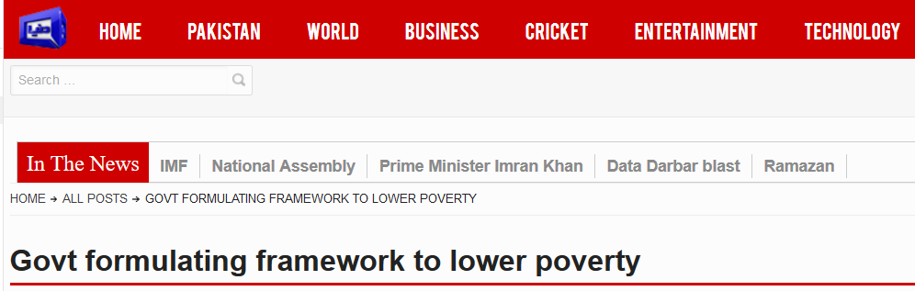
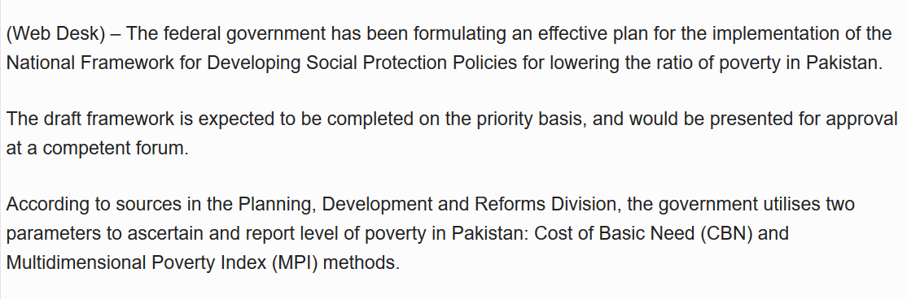
Pakistan

Slide 13
Policy makers are using their national MPIs to:
Complement monetary poverty statistics
Track poverty over time (official statistics)
Allocate resources by sector and by region
Target marginalized regions, groups, or households
Coordinate policy across sectors and subnational levels
Adjust policies by what works (measure to manage)
Leave No One Behind see the poorest & track trends
Be Transparent so all stakeholders engage – NGOs,
    Private Sector etc, all parts of government.
Notes:
New labels for Living Standard variables, old picture is behind

Slide 14
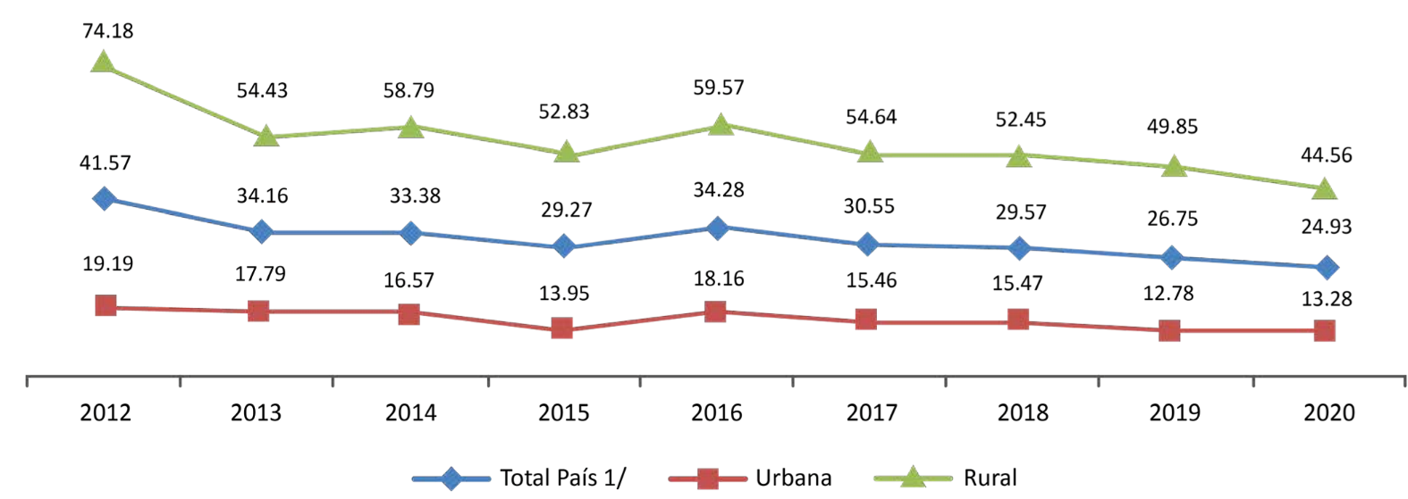
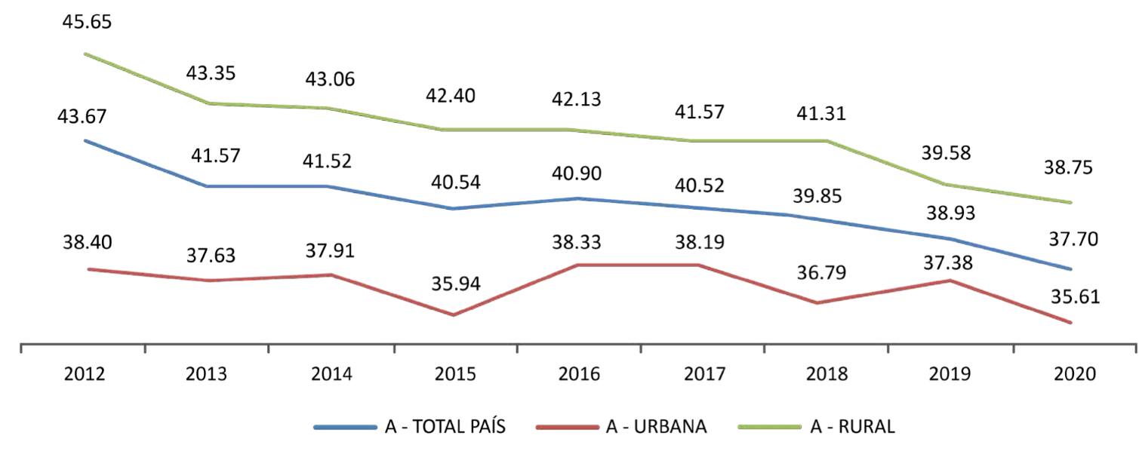
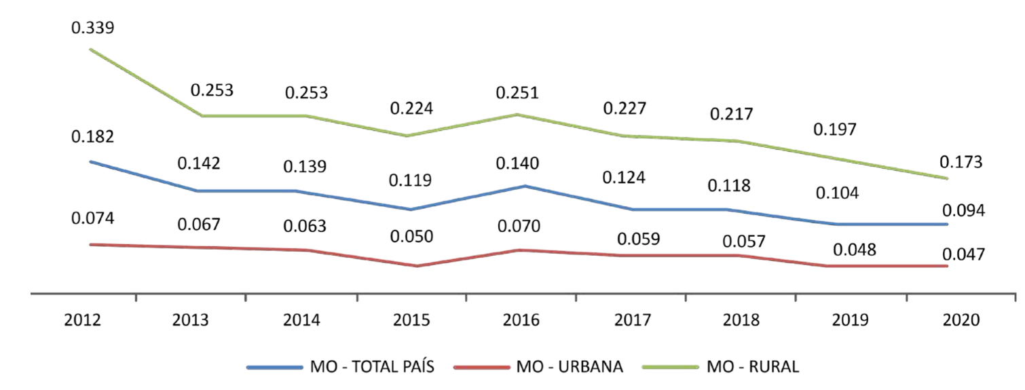
Multidimensional poverty incidence in Paraguay reduced from 41.6% in 2012 to
24.9% in 2020
The urban/rural gap is lower, with poverty intensity in rural areas reducing importantly

Slide 15
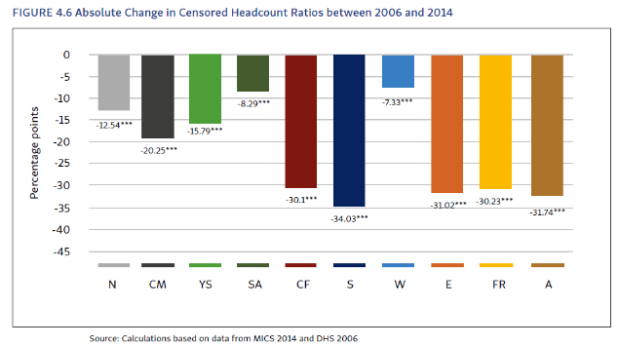
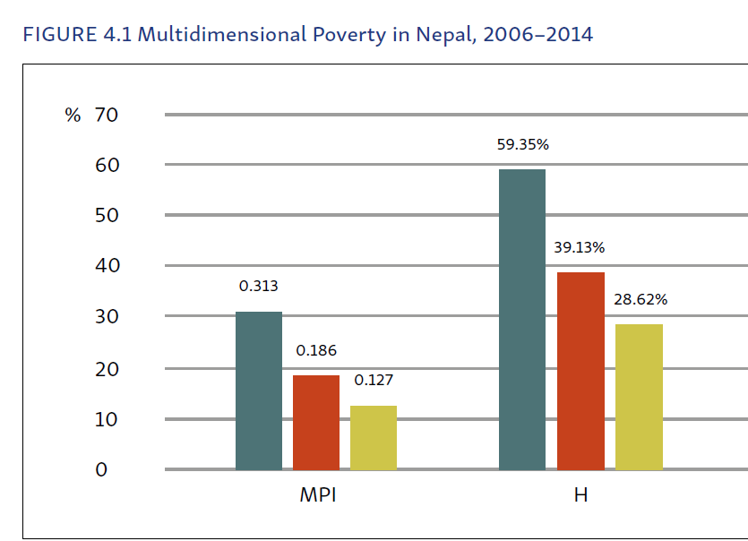
Nepal: MPI halved 2006-2014. Poverty rate fell from 59% to 28%
Every Indicator reduced significantly.
Notes:
New labels for Living Standard variables, old picture is behind

Slide 16
Policy makers are using their national MPIs to:
Complement monetary poverty statistics
Track poverty over time (official statistics)
Allocate resources by sector and by region
Target marginalized regions, groups, or households
Coordinate policy across sectors and subnational levels
Adjust policies by what works (measure to manage)
Leave No One Behind see the poorest & track trends
Be Transparent so all stakeholders engage – NGOs,
    Private Sector etc, all parts of government.
Notes:
New labels for Living Standard variables, old picture is behind

Slide 17
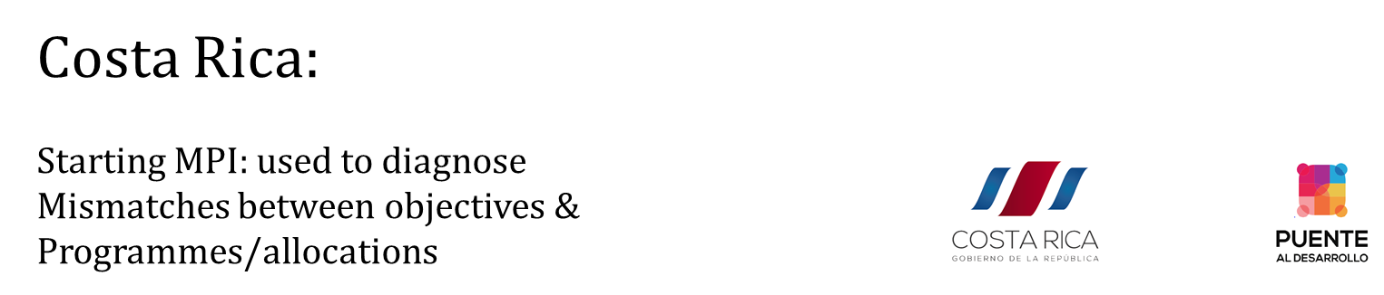
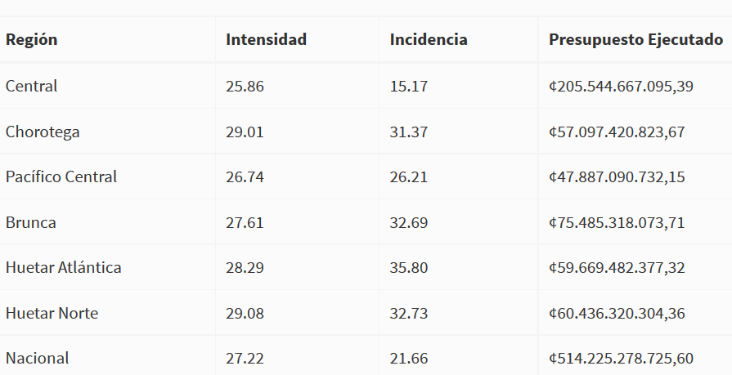
Does our allocation match our levels of poverty by region? (Not yet)
Region Intensity MPI Pov Rate Expenditure
(%) (%)

Slide 18
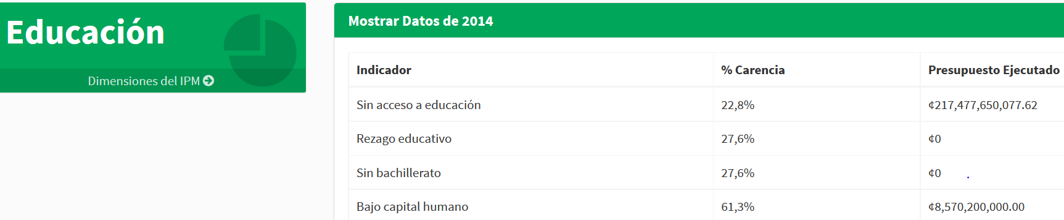

Costa Rica: Does our allocation match our
levels of poverty by sector? (Not yet)
Indicator % Deprived Expenditure
MPI: used to diagnose Mismatches between objectives & Programmes/allocations

Slide 19
Policy makers are using their national MPIs to:
Complement monetary poverty statistics
Track poverty over time (official statistics)
Allocate resources by sector and by region
Target marginalized regions, groups, or households
Coordinate policy across sectors and subnational levels
Adjust policies by what works (measure to manage)
Leave No One Behind see the poorest & track trends
Be Transparent so all stakeholders engage – NGOs,
    Private Sector etc, all parts of government.
Notes:
New labels for Living Standard variables, old picture is behind

Slide 20
Panama: MPI rates vary from 4.2% to over 90% in two Indigenous Comarcas
Leave No One Behind

Slide 21
Targeting Children? (or elders etc)
Child MPIs present information for children 0-17 as an example
  All countries disaggregate National MPI by children
  All countries include child relevant indicators like school attendance or nutrition
  Some countries create a linked Child MPI that consistently extends the national MPI
  Note: Some countries build an unlinked, standalone MPI for children. This is not usually advised as it must be used with care to avoid confusion and data fatigue. It is an option if 1) a linked Child MPI cannot be made and 2) the child MPI has a clear and distinct audience, so does not create confusion.

Slide 22
Policy makers are using their national MPIs to:
Complement monetary poverty statistics
Track poverty over time (official statistics)
Allocate resources by sector and by region
Target marginalized regions, groups, or households
Coordinate policy across sectors and subnational levels
Adjust policies by what works (measure to manage)
Leave No One Behind see the poorest & track trends
Be Transparent so all stakeholders engage – NGOs,
    Private Sector etc, all parts of government.
Notes:
New labels for Living Standard variables, old picture is behind

Slide 23



Costa Rica’s National MPI Changes Year on Year
Dimension | Indicator | 2015 | 2016 | Change | Improve Worsen
Health | Lack of Health Insurance | 63.0 | 63.4 | 0.4
 | Lack of clean water | 19.2 | 18.8 | -0.4
 | Lack of sanitation | 10.5 | 11.2 | 0.7
 | Lack of waste disposal | 28.5 | 27.3 | -1,2
Education | Not attending education | 12.9 | 12.2 | -0.7
 | Not at correct age for grade | 15.6 | 15.3 | -0.3
 | Not completed secondary education | 33.4 | 31.3 | -2.1
 | Low Human Capital Formation | 61.2 | 60.9 | -0.3
Housing and Internet | Inadeqaute roof and flooring materials | 42.7 | 44.3 | 1.6
 | Exterior walls in poor condition | 34.4 | 34.3 | -0.1
 | Overcrowding | 28.9 | 29.7 | 0.8
 | Without use of the internet | 49.9 | 40.8 | -9.1
Work | Long-term unemployment or discouraged | 10.8 | 10.7 | -0.1
 | Lack of labour rights | 52.7 | 56.8 | 4.1
 | Informal work | 28.4 | 27.3 | -1.1
Social | No child care | 10.2 | 10.5 | 0.3
 | Older persons lacking pension | 8.5 | 9.1 | 0.6
 | Persons with disability lacking support | 9.0 | 11.9 | 2.9
 | Out of the labour forcé due to care obligations to the family | 22.2 | 22.4 | 0.2

Slide 24
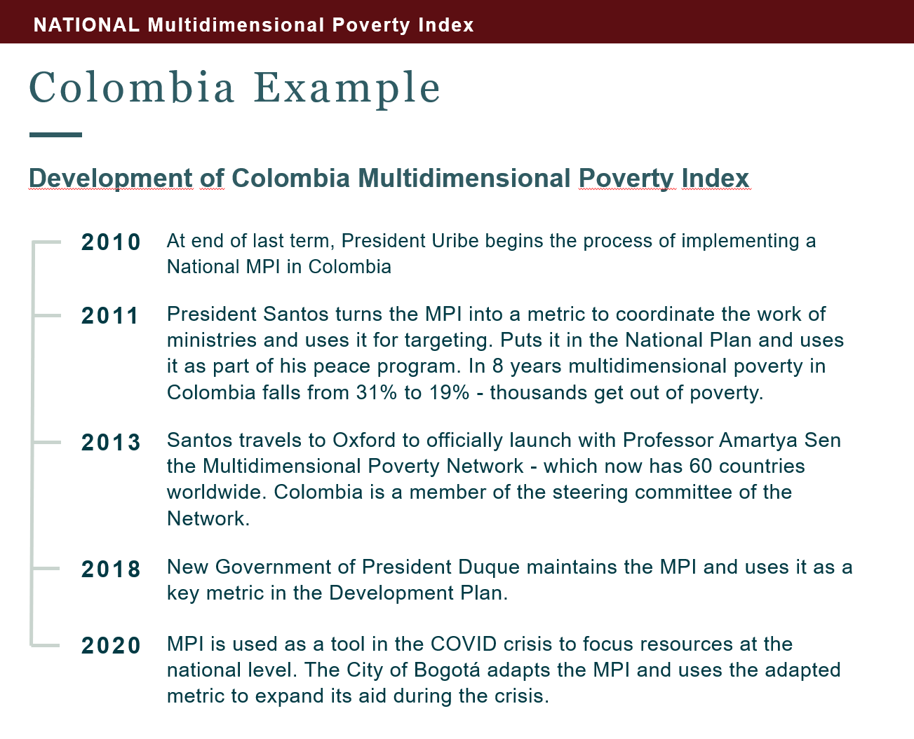
Policy Use over time

Slide 25
Policy makers are using their national MPIs to:
Complement monetary poverty statistics
Track poverty over time (official statistics)
Allocate resources by sector and by region
Target marginalized regions, groups, or households
Coordinate policy across sectors and subnational levels
Adjust policies by what works (measure to manage)
Leave No One Behind see the poorest & track trends
Be Transparent so all stakeholders engage – NGOs,
    Private Sector etc, all parts of government.
Notes:
New labels for Living Standard variables, old picture is behind

Slide 26
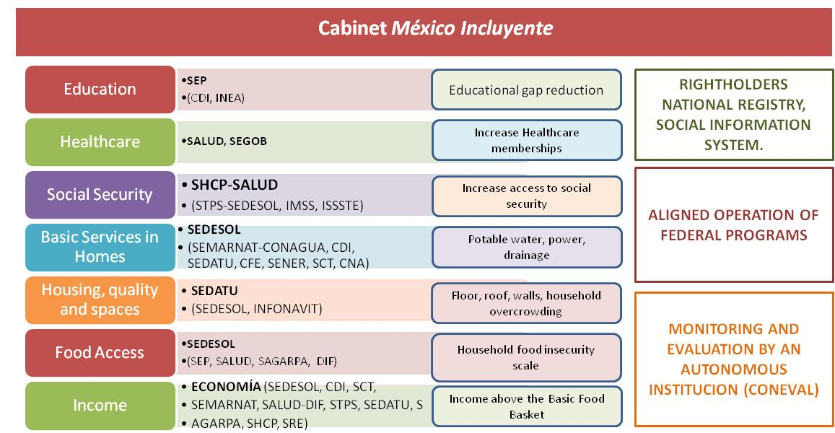
Gabinete Especializado México Incluyente
El Presidente de Mexico creo el Gabinete Incluyente. Cada Ministro nacional assume un compromise pleno en la reduccion de la pobreza multidimensional.

Slide 27
Policy makers are using their national MPIs to:
Complement monetary poverty statistics
Track poverty over time (official statistics)
Allocate resources by sector and by region
Target marginalized regions, groups, or households
Coordinate policy across sectors and subnational levels
Adjust policies by what works (measure to manage)
Leave No One Behind see the poorest & track trends
Communicate with all: NGOs, Private Sector, students, all parts of government.
Notes:
New labels for Living Standard variables, old picture is behind

Slide 28
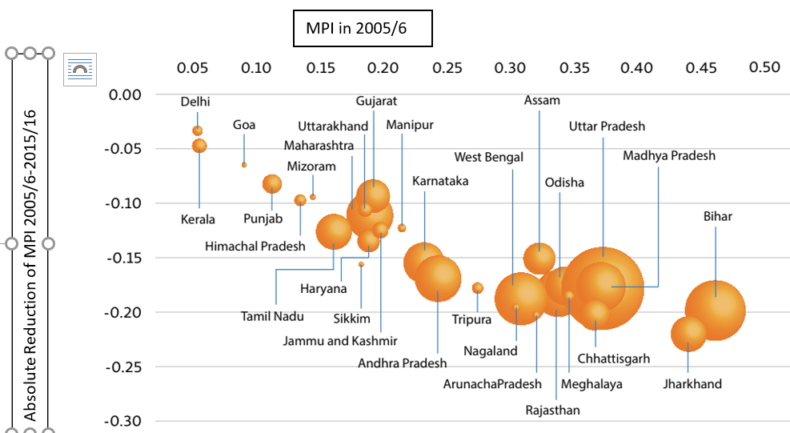
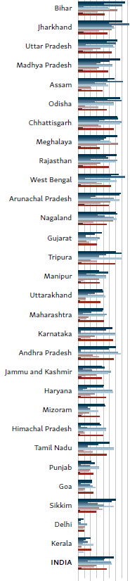
India Global MPI 2005/6-15/16: Poorest reduced fastest

Slide 29
Policy makers are using their national MPIs to:
Complement monetary poverty statistics
Track poverty over time (official statistics)
Allocate resources by sector and by region
Target marginalized regions, groups, or households
Coordinate policy across sectors and subnational levels
Adjust policies by what works (measure to manage)
Leave No One Behind see the poorest & track trends
Communicate with all: NGOs, Private Sector, students, all parts of government.
Notes:
New labels for Living Standard variables, old picture is behind

Slide 30
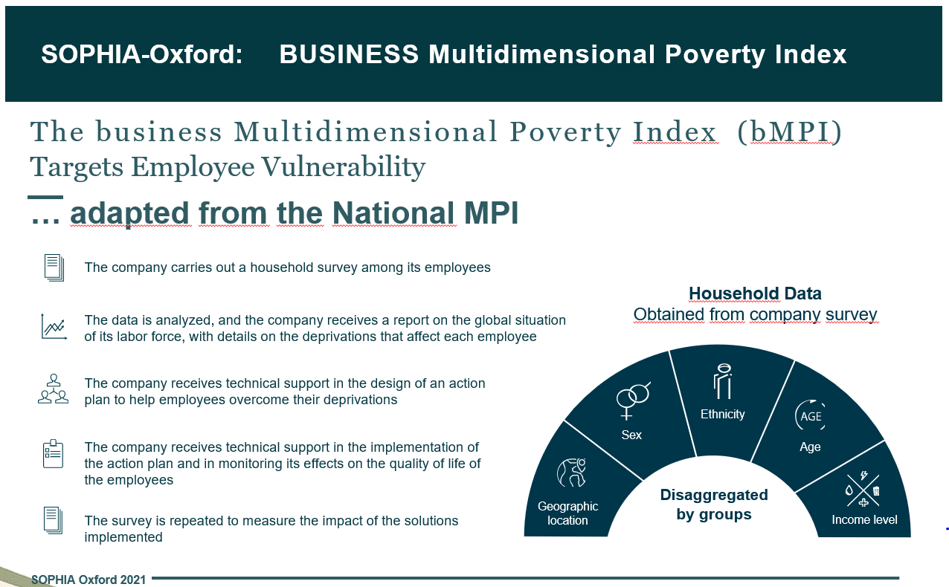
Wise Responder / Sopha engages business in reducing poverty using the National MPI

