Slide 1
Social protection and poverty
Beirut, 9 June 2022

Slide 2
MPIs enable informed design and evaluation of social protection programmes and systems.
MPIs can help policy makers understand what social protection measures are needed in a specific context (e.g. a geographic area), including after a shock.
MPIs can inform complementarities between social protection programmes and other social policy interventions.

Slide 3
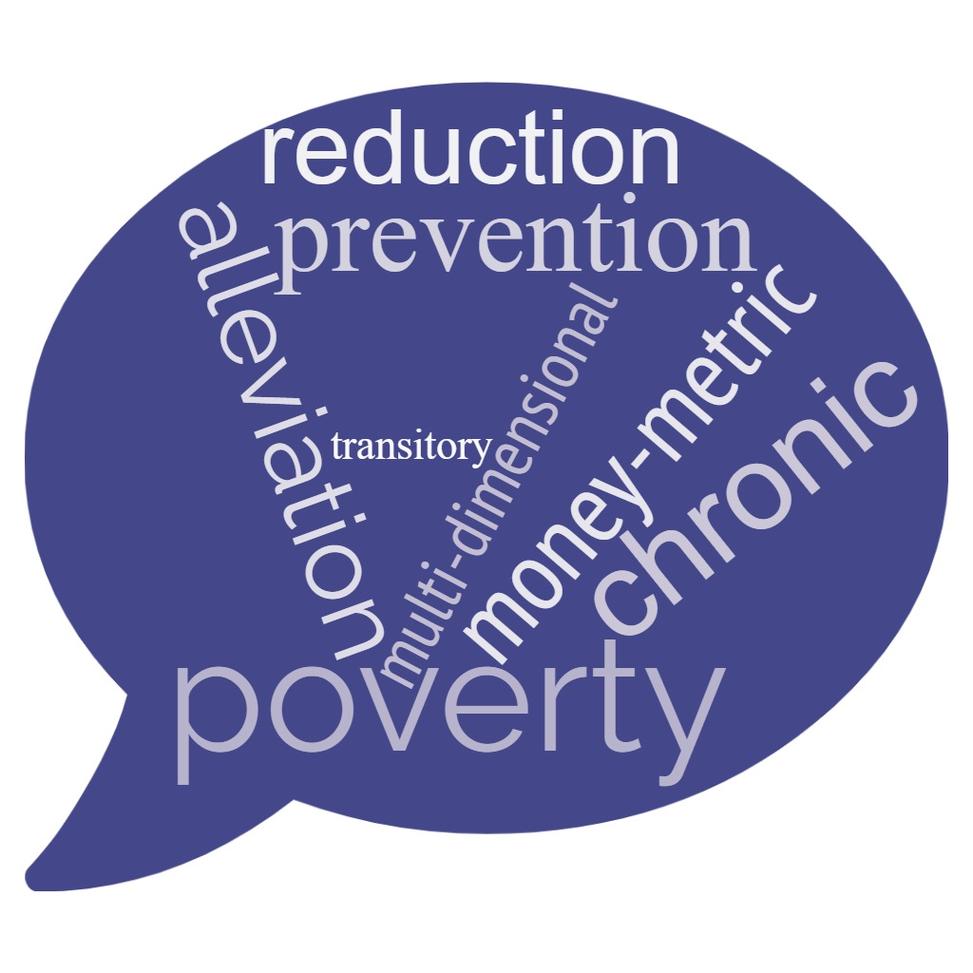
Which aspects of poverty are we talking about?

Slide 4
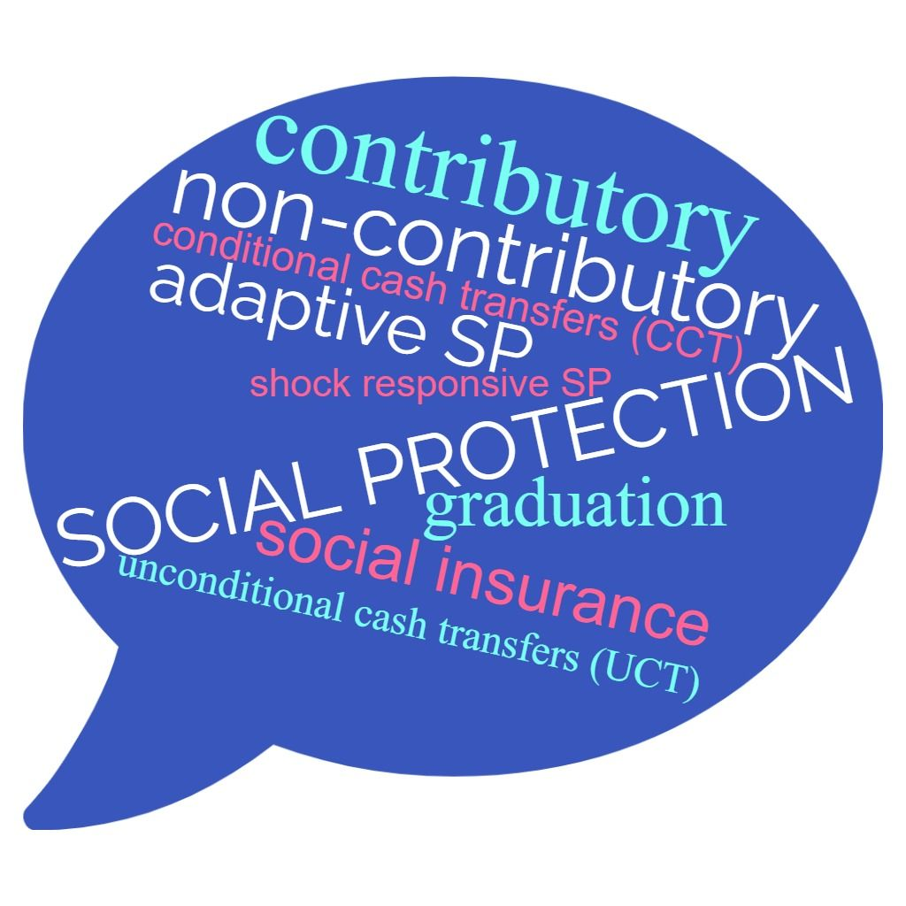
The world of social protection is likewise complex, so….

Slide 5
Types of Social Protection
Social insurance (contributory social protection)
Old-age pensions, disability benefits, health insurance, family benefits…
Financed by contributions from employees and employers (and sometimes by Governments)
Limited to workers in the formal economy
Social assistance (non-contributory social protection)
Subsidies, cash transfers, in-kind benefits, non-contributory health coverage...
Financed by general Government revenue
Universal (provided to everyone) or targeted (provided to selected groups)
Notes:
Social insurance, which can include for instance old-age pensions, disability benefits, and family benefits.
Social insurance is in principle financed by contributions paid by employers and employees. However, in practice social insurance funds are often also supported by Government revenue.
The idea of social insurance is that eligibility is limited to those who have previously paid contributions. In practice, this means that informal workers are excluded. The same goes for those who are excluded from the labour market altogether, which in the Arab region is often the case for women and persons with disabilities. Migrant workers are another group that is frequently excluded from social insurance coverage.
Social assistance, on the other hand, includes for instance subsidies, cash transfers, in-kind benefits and various forms of non-contributory health coverage.
Unlike social insurance, social assistance is financed by general Government revenue rather than by contributions.
Social assistance can be either universal, in which case it is provided to everyone, or targeted, in which case it is provided only to specific groups. In either case, eligibility is not based on previous contributions.

Slide 6
reductive
…let’s disentangle:
TVET
preventive
Graduation approaches
c
Micro- business
Human capital
Social health insurance
Conditional cash transfers
Social Protection
Non- contributory
Contributory pensions
Contributory
Unconditional cash transfers
Unemployment
benefit
d
alleviative
Shock responsive SP
Notes:
Different types of social protection tackle different types of poverty.
The different types of social protection focusing on different types of poverty did not emerge at the same time. Initially, the focus was largely on social insurance schemes aiming to prevent transitory poverty. Later the need to complement these with social assistance schemes alleviating chronic poverty became evident. During the last two years, a lot of focus has been on social protection alleviating transitory poverty caused by covariate shocks, such as covid-19.
However, any specific social protection scheme or programme usually relates to several poverty types at the same time.
For example, The Takaful programme in Egypt is a conditional cash transfer programme focused on education and health. It is concerned with reducing multidimensional poverty and create a path for graduation from poverty.
The Takaful is targeted to families with children, who might be able to work. A sister programme, Karama, is targeted to older persons and persons with disabilities, with a more poverty alleviative objective. During Covid, both Takaful and Karama were rapidly expanded to a larger number of new beneficiaries, aiming to alleviate the negative effects of the pandemic.
TVET = technical and vocational education and training

Slide 7
Social assistance in Arab countries
 | Targeting |  |  |  | Conditionalities
 | PMT | Community | Geographical | Categorical | Education | Health | Other
Unified CT Program (Jordan)
Tekavoul (Mauritania)
Takaful & Karama (Egypt)
Amen Social (Tunisia)
Tayssir (Morocco)
NCTP (Palestine)
Notes:
Here is a matrix that gives an overview of some key cash transfer programmes in the Arab countries, showing their targeting methodologies as well as whether they have any conditionalities.
All programmes in the matrix use some kind of proxy means testing, usually in combination with some other targeting methodology such as community targeting, geographical targeting or categorical targeting. MPI can prove useful in targeting, especially in geographical targeting (poverty maps).
Light blue indicates that the targeting methodology plays a secondary role or that it was previously used – for example in Egypt, Morocco and Palestine, community targeting is used to correct errors, whereas in Mauritania community targeting plays a more central role in the identification of beneficiaries. Also, the programmes in Mauritania, Egypt and Morocco were first implemented with geographical targeting, in the poorest areas, but have now been implemented at a national level.
Meanwhile, categorical targeting is mainly used for the programmes in Egypt and in Mauritania.
So, turning to the right side, we see that there are mainly three programmes that have conditionalities, namely those in Mauritania, Egypt and Morocco. Tekavoul in Mauritania has conditions relating to participation in awareness sessions, while
Takaful and Karama in Egypt has conditions relating to both education and health.
The Tayssir programme in Morocco only has conditions relating to education, and in fact the programme is implemented by the ministry of education and not the ministry of social affairs.

Slide 8
Intersections between different types of social protection and the MPI
 |  | Unconditional cash transfers | Conditional cash transfers | Fee waivers | In-kind transfers | Productivity enhancing programs
Health and nutrition | 1. Infant mortality
 | 2. Child nutrition
 | 3. Early pregnancy
Education | 4. School attendance
 | 5. Education gap by age
 | 6. Level of education 18+
Housing | 7. Crowding
 | 8. Type of housing
Access to services | 9. Improved water
 | 10. Improved sanitation
 | 11. Electricity
Assets | 12. Communication assets
 | 13. Mobility assets
 | 14. Livelihoods
Social protection
Contribu- tory
Social insurances
Non- contribu- tory
SRSP / ASP
graduation
conditional cash transfers
UCT
Source: ESCWA (2022)

Slide 9
Delivery Mechanism / Implementation
SP Strategy Design
MPI
relevance
Outreach
Intake & registration
Target groups?
Targeted / universal ?
Assess needs & conditions
Type of benefit (cash/in-kind)?
Eligibility & enrollment decision
Conditional / unconditional ?
Determination of benefits
Notification & onboarding
Benefit amount & frequency ?
Payment mechanism
HH / families / individuals?
Services & GRM
Additional / referral services?
Exit
Exit / graduation
Political will
Action Plan / Road Map
Diagnostics of SP Landscape and Needs
Which tasks / priorities?
SP Strategy Lifecycle (ideal scenario)
By whom?
By when?
Costs / budget allocation?

Slide 10
Social Assistance and Multidimensional Poverty: Global Lessons
Colombia’s Conditional Cash Transfers “Más Familias en Acción”
Aimed at households with children under the age of 18 who are in poverty, displaced, or part of an indigenous population.
Geographical targeting and MPI
A proxy of the national MPI-Colombia was constructed at the municipal level. Poverty maps were created and used for targeting purposes at the geographical level.
Coverage took into account the magnitude of poverty in each territory, maximising impact.
Progressive geographical coverage over 7 years that differentiated the municipalities according to the levels of poverty and urbanization:
1. Bogotá,
2. the 21 main capital cities,
3. Municipalities with a MPI below 70%, and
4. Municipalities with a MPI above 70%.

Slide 11
Social Assistance and MPI: Global Lessons (cont.)
Colombia’s Conditional Cash Transfers “Más Familias en Acción”
Eligibility criteria and MPI
The criteria coincide with the variables of the national MPI. The MIS identifies and ranks individuals according to their living conditions on these dimensions: health, education, housing and vulnerability. This not only allows the identification of the poor, but of the individuals who are at risk of being poor.
Benefit level and MPI
Greater in priority municipalities.
Graduation and the MPI
MPI is now used alongside income poverty measures as a condition for graduating families. Families classified as non-multidimensionally poor and non-income poor, exit out of the programme.

Slide 12
Social Assistance and MPI: Global Lessons (cont.)
IMPACT of cash transfers on multidimensional poverty as measured by MPI
MPI with 10 indicators grouped into 3 dimensions: Education (years of schooling and school attendance), Health (nutrition and child mortality) and Standard of Living (access to electricity, sanitation, water, flooring material, cooking fuel, and asset ownership)
Impact of three very different large-scale social assistance schemes in 3 different contexts (Ethiopia, India and Peru)
India and Ethiopia introduced in 2005, with a “workfare” approach (=work requirement)
Peru also introduced at same time but no work requirement – Conditional cash transfer.
Panel data collected in 5 surveys from 2002 to 2016 in all 3 countries (Young Lives dataset)

Slide 13
Social Assistance and MPI: Global Lessons (cont.)
Impact: beneficiaries had an improvement in MPI scores relative to non-participants
Positive impact on asset formation, livestock holding and some living standard indicators
Impacts sustained over the medium and long-term (aprox. 10 years)
Conditionalities in Peru had long term impact on child school attendance and schooling.
Mechanisms through “monetary poverty”- eg. Improvements in assets and extra income has been used to improve housing quality.

Slide 14
Thank you! | شكرا

