Slide 1

Migrant Women in the Arab Region
Milad Pournik
Associate Social Affairs Officer
ESCWA
June 22, 2023

Slide 2
Overview of Migration Trends in the Arab Region

Slide 3
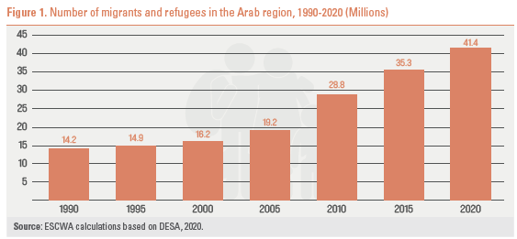
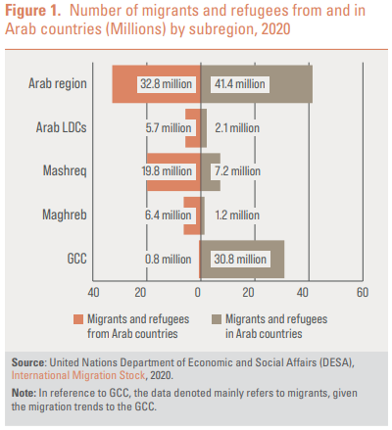
Migration to and from the region
Notes:
Number of migrants and refugees in the region as share of the global world.
In 2020, the 41.4 million migrants and refugees in the Arab region represented 15 per cent of migrants and refugees globally vs. 14.2 million in 1990, which made up around 9 per cent of the total number worldwide.
The number of international migrants and refugees originating from the Arab region has grown from approximately 10.8 million in 1990 to 32.8 million in 2020

Slide 4
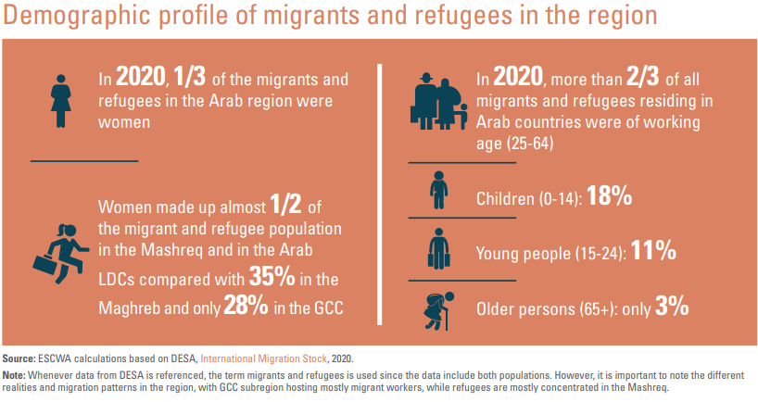
Demographics

Slide 5
Frameworks and conventions on migrant women

Slide 6

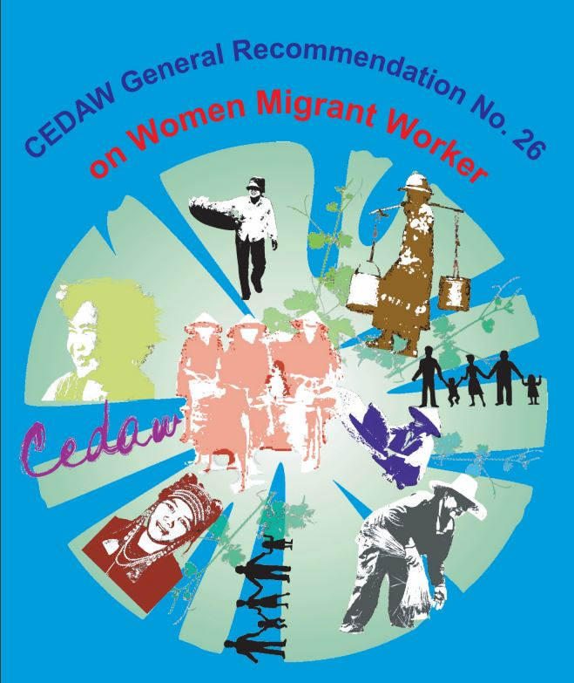

International Convention on the Protection of the Rights of All Migrant Workers and Members of Their Families (1990)
CEDAW: General recommendation No. 26 on women migrant workers (2009)
GCM (2018)

Slide 7
Overlap with Beijing critical areas

Slide 8
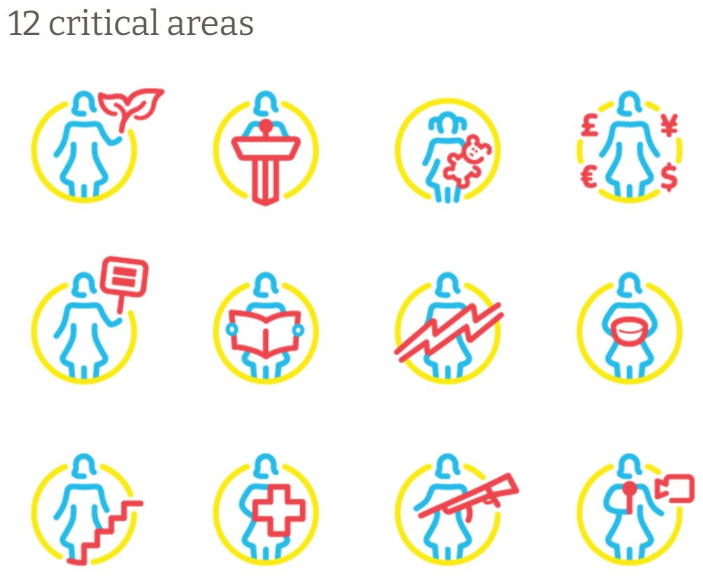
Notes:
Violence against women
Women and armed conflict
Women and the economy

Slide 9
Key Recommendations
Ideas for the way forward

Slide 10
social protection reaches migrant and refugee women and girls
Ensure
female migrants & refugees are aware of and can access protection services, including safe houses
Involve
women in critical decision-making efforts
Develop
sex-disaggregated data and undertake gender analysis on the socio-economic situation of women migrants
labor law coverage in line with ILO & CEDAW standards, including for domestic workers
Guarantee
Strengthen
gender-responsive policies and programs (pre-departure and post-arrival)
Ensure

Slide 11
Key Resources

Slide 12
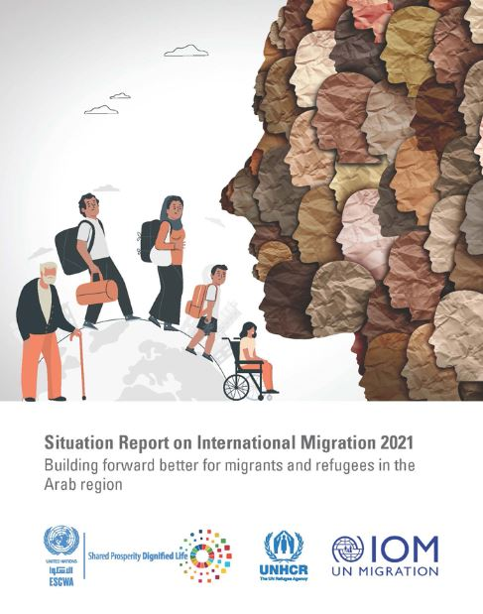
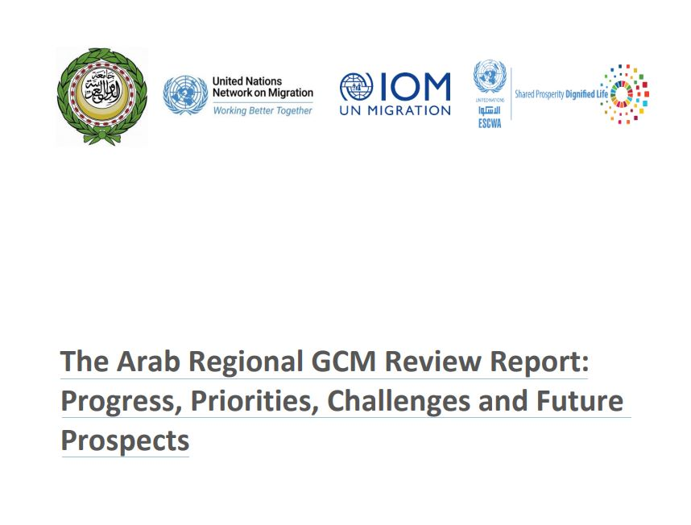
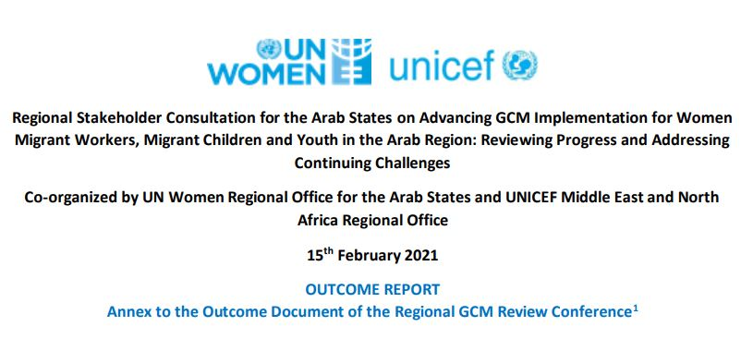

Slide 13

Thank you

