Slide 1
Introduction to the Technical Report on Measuring SDG Indicators through Population and Housing Census
and Civil Registration Data
Seiffe Tadesse
United Nations Statistics Division

Slide 2
Outline
Background
Overview of data sources for the global SDG indicators
Why PHC and CRVS are important for monitoring SDGs
Challenges in the use of PHC and CRVS data
Objectives of the technical report
Target audience
Criteria used for selection of SDG indicators
Organization of the content of report

Slide 3
Background – reasons for the technical report
The Sustainable Development Goals (SDGs) were established in the spirit of leaving no one behind, meaning all goals need to be reached for everyone
PHC and CRVS play a major role in providing information for all population groups in a country
Monitoring SDGs requires reliable, accessible and timely population and demographic data – out of 230+ SDG indicators, about 90 indicators (40%) are related to population
The UN Principles and Recommendations for Population and Housing Censuses, Revision 3 and other UN guidelines emphasize the importance of integrating the data requirements for monitoring SDGs indicators into plans for 2020 round of censuses

Slide 4
Overview of data sources for the global SDG indicators
Main data sources for monitoring SDG indicators include:
Household surveys
Administrative records
Civil Registration
Population and housing censuses
Geospatial information
9.1.1 - Proportion of the rural population who live within 2 km of an all-season road
11.7.1 - Average share of the built-up area of cities that is open space for public use for all, by sex, age and persons with disabilities

Slide 5
Why PHC and CRVS are important for monitoring SDGs
Population and housing censuses
are a unique data source for collecting information on all individuals and housing units in a country … on a wide range of topics related to population, demography and housing … which can be disaggregated by small population groups and small geographic areas
in most countries, PHC is the only source available for producing information on population count and its distribution, on small population groups (such as international migrants, people with disabilities and population living in slum areas, etc.) as well as on housing conditions
overall, the census can potentially provide reliable data for about 90 SDG indicators (40% of SDGs), either directly or through population projections based on census data
because PHC are based on the entire population, they are not affected by sampling errors, which household surveys are prone to

Slide 6
Why PHC and CRVS are important for monitoring SDGs
Civil registration and other administrative registers
are ideal data sources for producing periodical and reliable information on some SDG indicators related to births, deaths, and many other topics (such as health, education, social protection etc.)…. however, in many countries, these sources are not universal and complete
because CRVS data are based on the entire population, they are not subject to sampling errors

Slide 7
Main challenges in the use of PHC and CRVS data
PHC data must serve a wide range of purposes
so, the amount of detail that can be provided on each individual topic is limited, as PHC questionnaires do not lend themselves to lengthy and detailed interviews
the quality of information collected in PHC on certain social, demographic and economic characteristics tend to be lower than what can be achieved in specialized HH surveys
in the case of CRVS, the coverage of CRVS in some countries is not universal
The fact that PHC are typically carried out only once every ten years limits their capacity to produce data that need to be updated on a regular basis for monitoring SDGs

Slide 8
Objectives of the technical report
Overall objectives:
plan their PHC by taking into account the data requirements for monitoring SDGs indicators
making the best possible use of the information that is already routinely collected in PHC and CRVS systems
Specific objectives include:
identify SDG indicators that can be fully/partly produced using PHC/CRVS data
highlight the advantages of PHC/CRVS for the disaggregation of SDG indicators
highlight the major challenges posed by the use of PHC or CRVS in the measurement of SDG indicators and suggest potential analytical strategies to mitigate challenges
provide suggestions on topics/questions that might be added to PHC questionnaires with a comparatively small investment

Slide 9
Target audience
Users who may actually use Technical Report as a manual for computing SDG indicators from PHC and CRVS data
Users who work on methodological aspects of the PHC or CRVS and looking for guidance on how to improve the use of these sources; and,
Those who are looking for an assessment of the relative benefit of using different data sources, particularly the value of data from PHC and CRVS

Slide 10
Criteria used for selection of SDG indicators
The report includes Tier 1 and Tier 2 indicators, as methodology or standards of Tier 3 indicators are not yet available
Tier 1: Indicator is conceptually clear, has an internationally established methodology, and standards are available, and data are regularly produced by many countries (at least 50 per cent of countries and of the population in every region where the indicator is relevant)
Tier 2: Indicator is conceptually clear, has an internationally established methodology and standards are available, but data are not regularly produced by countries
Tier 3: No internationally established methodology or standards are yet available for these indicators, but methodology/ standards are being (or will be) developed or tested

Slide 11
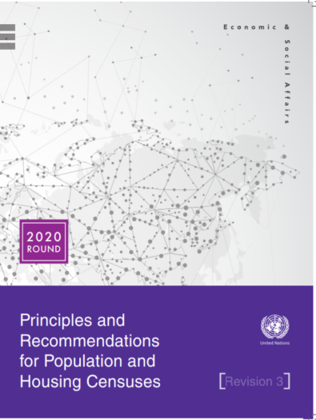
Criteria used for selection of SDG indicators
SDG indicators contained in the technical report were selected taking into account the topics recommended in two international methodological guidelines:
UN Principles and Recommendations for Population and Housing Censuses, Revision 3
UN Principles and Recommendations for a Vital Statistics System, Revision 3

Slide 12
Criteria used for selection of SDG indicators
It is important to note that …there is considerable heterogeneity / diversity in terms of the data needed for measuring SDG indicators
Analysis of SDG metadata indicates that:
For some indicators, the PHC or CRVS is the natural data source for measuring these indicators
For other indicators, the PHC merely contributes some proxy or ancillary information that contributes to the measurement of these indicators

Slide 13
Criteria used for selection of SDG indicators
SDG indicators are classified into the following four groups:
Group I - Indicators for which the PHC is the most obvious source, even though alternative data sources (including CRVS) may be available and in some cases are of better quality
Group II - Indicators for which the CRVS is the most obvious source (however, due to problems of data quality, in many countries, these indicators may be measured PHC or data from other sources)

Slide 14
Criteria used for selection of SDG indicators
Group III - Indicators for which the PHC provides proxy estimation that can help in measuring some SDG indicators or enhancing understanding, particularly in regard to disaggregation to specific population groups
Group IV - Indicators for which the PHC provides ancillary information that could be used for analytical purposes but that by itself is insufficient to fully take account of the indicator

Slide 15
Structure of the report
The report has four chapters:
Chapter I – Introduction (background information, objectives, target audiences, etc.)
Chapter II – SDG Indicators that can be measured fully or partly through PHCs and CRVSs
Chapter III – Detailed analysis of the selected SDG Indicators
Chapter IV – Conclusions and recommendations
New chapter (work in progress) – Geospatial information, and GIS tools for measuring, disaggregating and visualizing SDG indicators

Slide 16
Organization of the content of report (components of detailed analysis for each SDG indicator)
For each indicator in the Tech Report, detailed discussions are provided for each of the following items:
Concept and definition: Operational definition of the indicator according to the SDG meta-data repository;
Possible data sources: The possible data sources are examined from the point of view of measuring the indicator in the context of national SDG monitoring ….and in terms of their relative advantages and disadvantages;
Method of computation: Standard computation of the indicator according to the SDG meta-data and alternative approaches of the computation or approximation of the indicator based on PHC;

Slide 17
Organization of the content of report
(components of detailed analysis for each SDG indicator)
d. Challenges in using PHC or CRVS data: Challenges that can emerge in estimating the relevant indicators from PHC/CRVS data are discussed; such challenges usually are related to:
imperfect correspondence between the PHC concept and SDG metadata
deficient quality of the data as measured in the PHC or the CRVS
e. Data disaggregation: Disaggregation of the indicator by the various relevant categories, such as urban/rural area, major geographical divisions, sex, age, educational strata, migration and disability status, etc.

Slide 18
SDG indicators that can be measured wholly or partly through PHC and CRVS data
PHC and CRVS can provide data for 40 indicators
related to 12 Goals out of 17

Slide 19
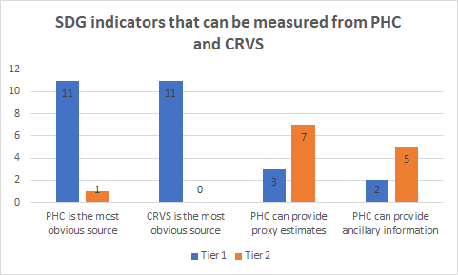
Distribution of the selected indicators by Group / Tier
Tier 1- produced by at least half of countries
Tier 2- not regularly produced by countries
PHC produces information for five indicators

Slide 20
Technical report is available at UNSD website: https://unstats.un.org/unsd/demographic-social/census/documents/tr_on_sdg_in_phc_crvs.pdf

